Slide 1
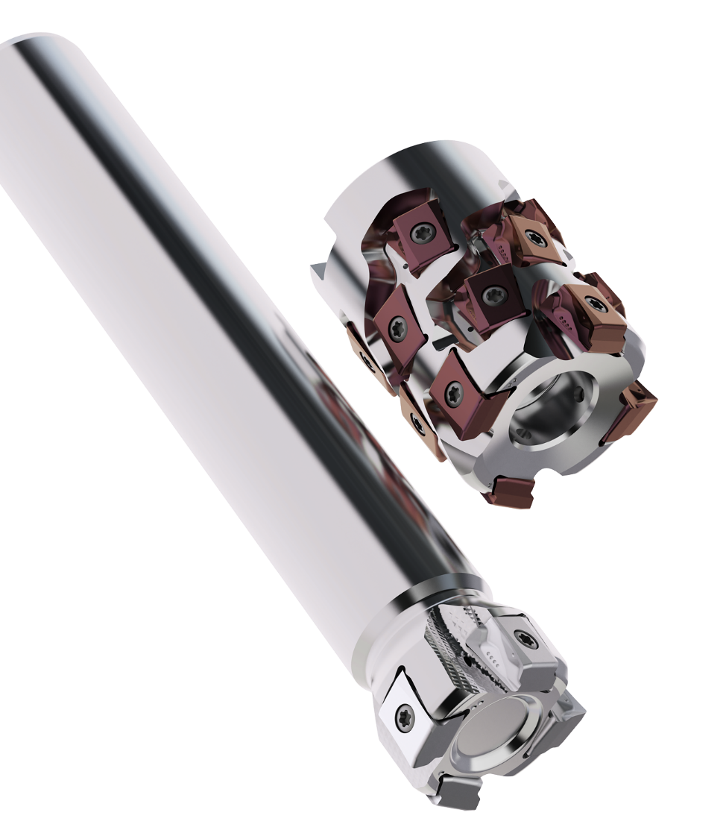
Square T4-12
Upgrade
Product presentation

Slide 2
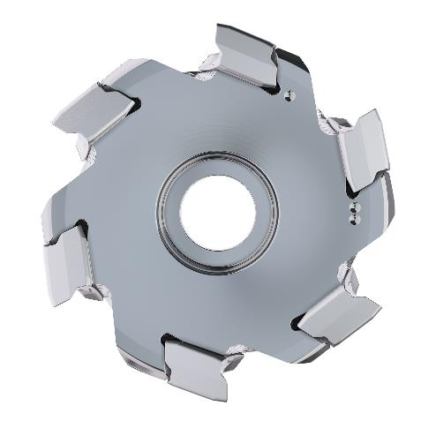



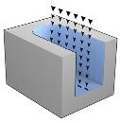
Benefits of tangential cutter
Product Family Overview
Increased process rigidity
Easier insert changes
Square wall surfaces
Largest assortment insert radii
Wide range of milling applications
Side milling
Face milling
Slot milling
Plunge milling

Slide 3
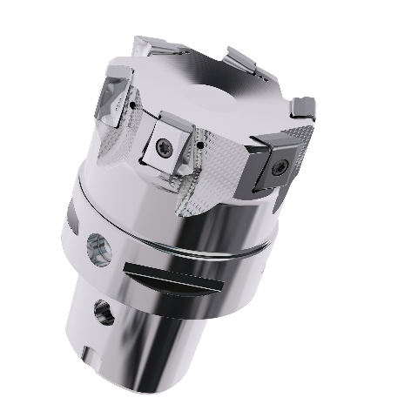
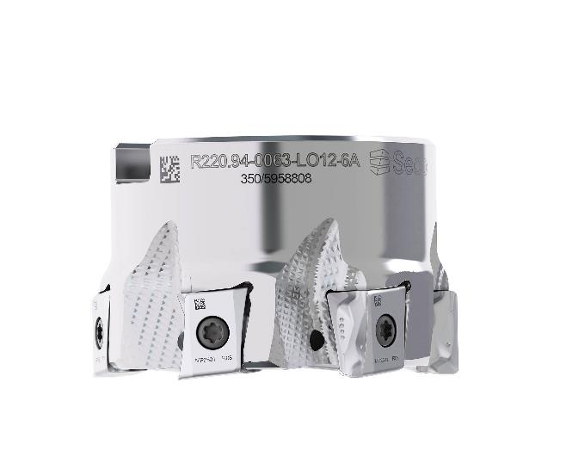
Square T4-12 Upgrade
Cutter Body Portfolio
Product Family Overview
Product Range
Square Shoulder & Helical
Ø1.0” – 6.0” [25mm - 125mm]
Coarse & Close Pitch
DOC .472” [12mm]
Radius .0.016” – 0.248”
Available Backend Connections
Cylindrical
Weldon / Seco-Weldon
Seco-Capto
Combimaster
Arbor

Slide 4
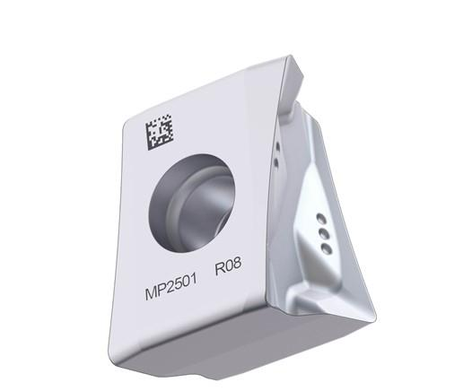
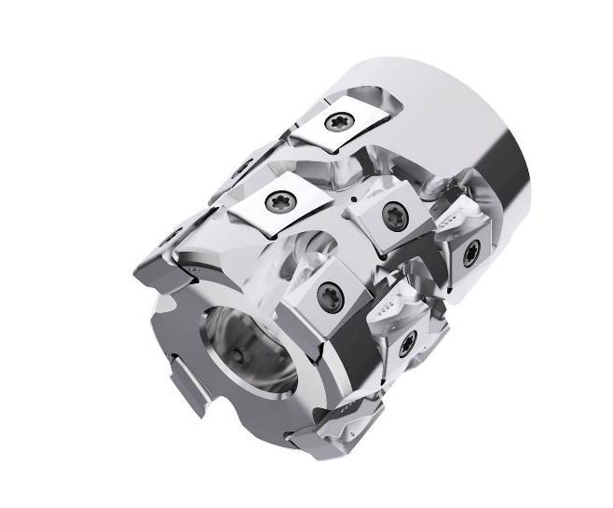
Square T4-12 Upgrade
Insert Range Options
Product Family Overview
LOEX120708TR-T4-M12
Soft cutting for Steel and easier stainless
LOEX120708R-T4-M09
Sharp edge for super alloys
LOEX120708TR-T4-MD13
Strong edge for challenging setups and cast iron
CVD Grades
MP1501
MP2501
MP3501
MK1500
MS2500
MM4500
PVD Grades
F40M
MP2050
MP3000
MK2050
MS2050

Slide 5
Square T4-12 Upgrades
Review the specific improvements to this product

Slide 6
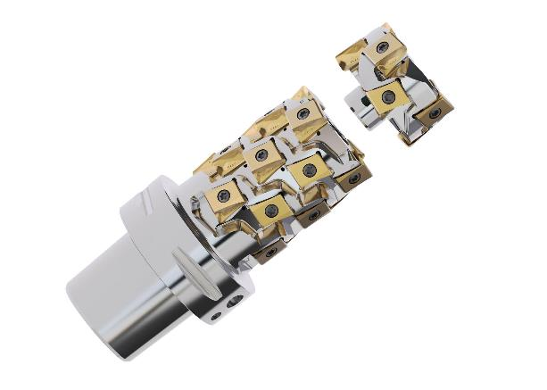
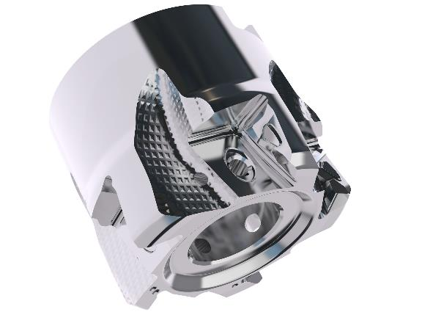
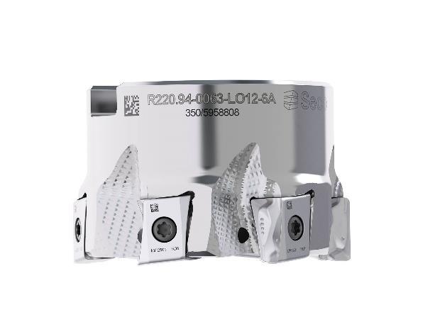
Square T4-12 Upgrade
Product Upgrades
Square T4-12 Upgrades
Changes in cutter body
Updates in the coolant
Data matrix code
Improved pocket geometry
New body material
PVD CrN coating
Diamond pattern in the flutes
Increase in coolant pressure
Optimized orientation
Added to the 6inch cutter
Added to all inserts and bodies
Data matrix code (DMC)

Slide 7
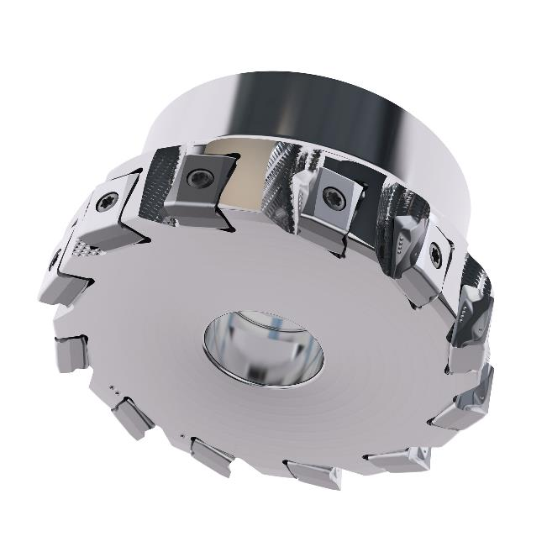


Square T4-12 Upgrade
Compatibility old Square T4-12
Square T4-12 Upgrades
New cutters compatible with old inserts
New inserts compatible with old bodies
Best performance from new inserts with new body
Compatibility & performance
 | Old insert | New insert
Old cutter
New cutter
Compatibility
Performance

Slide 8
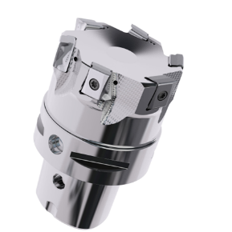
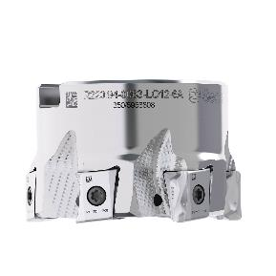
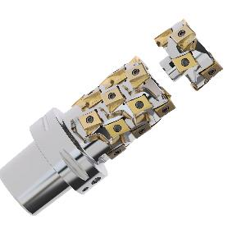
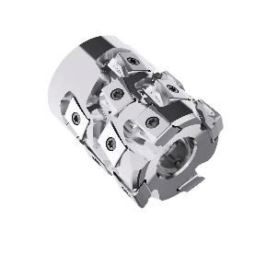
Square T4-12 Upgrade
Cutter Body Portfolio
Product Family Overview
115
Count of GPNs
Seco Discount Group
Seco Milling Range
Inserts
A09
Bodies
B09
Square Shoulder
39 GPNs
Helical Milling
21 GPNs
Cylindrical: 5 GPNs
Weldon: 8 GPNs
Seco-Capto:8 GPNs
Combimaster: 5 GPNs
Arbor: 33 GPNs
Seco Insert Range
Country of Origin
M12: 24 GPNs
M09: 19 GPNs
MD13: 12 GPNs
CVD Grades
17 GPNs
PVD Grades
38 GPNs
Sweden
France

Slide 10
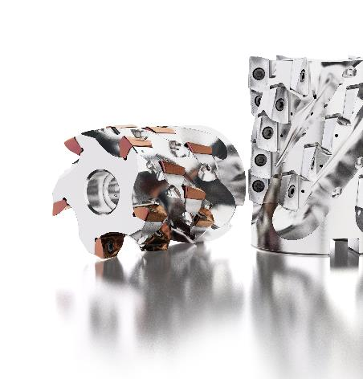

Thank you!
Product Manager Americas
Indexable Milling | Indexable Drilling | Boring Systems | Tooling Systems
Focused on Growth
Jay McCord
Tel. +01 (832) 248-3824
jay.mccord@secotools.com

