Slide 3
Product launch 2024.1
Overview

Slide 4
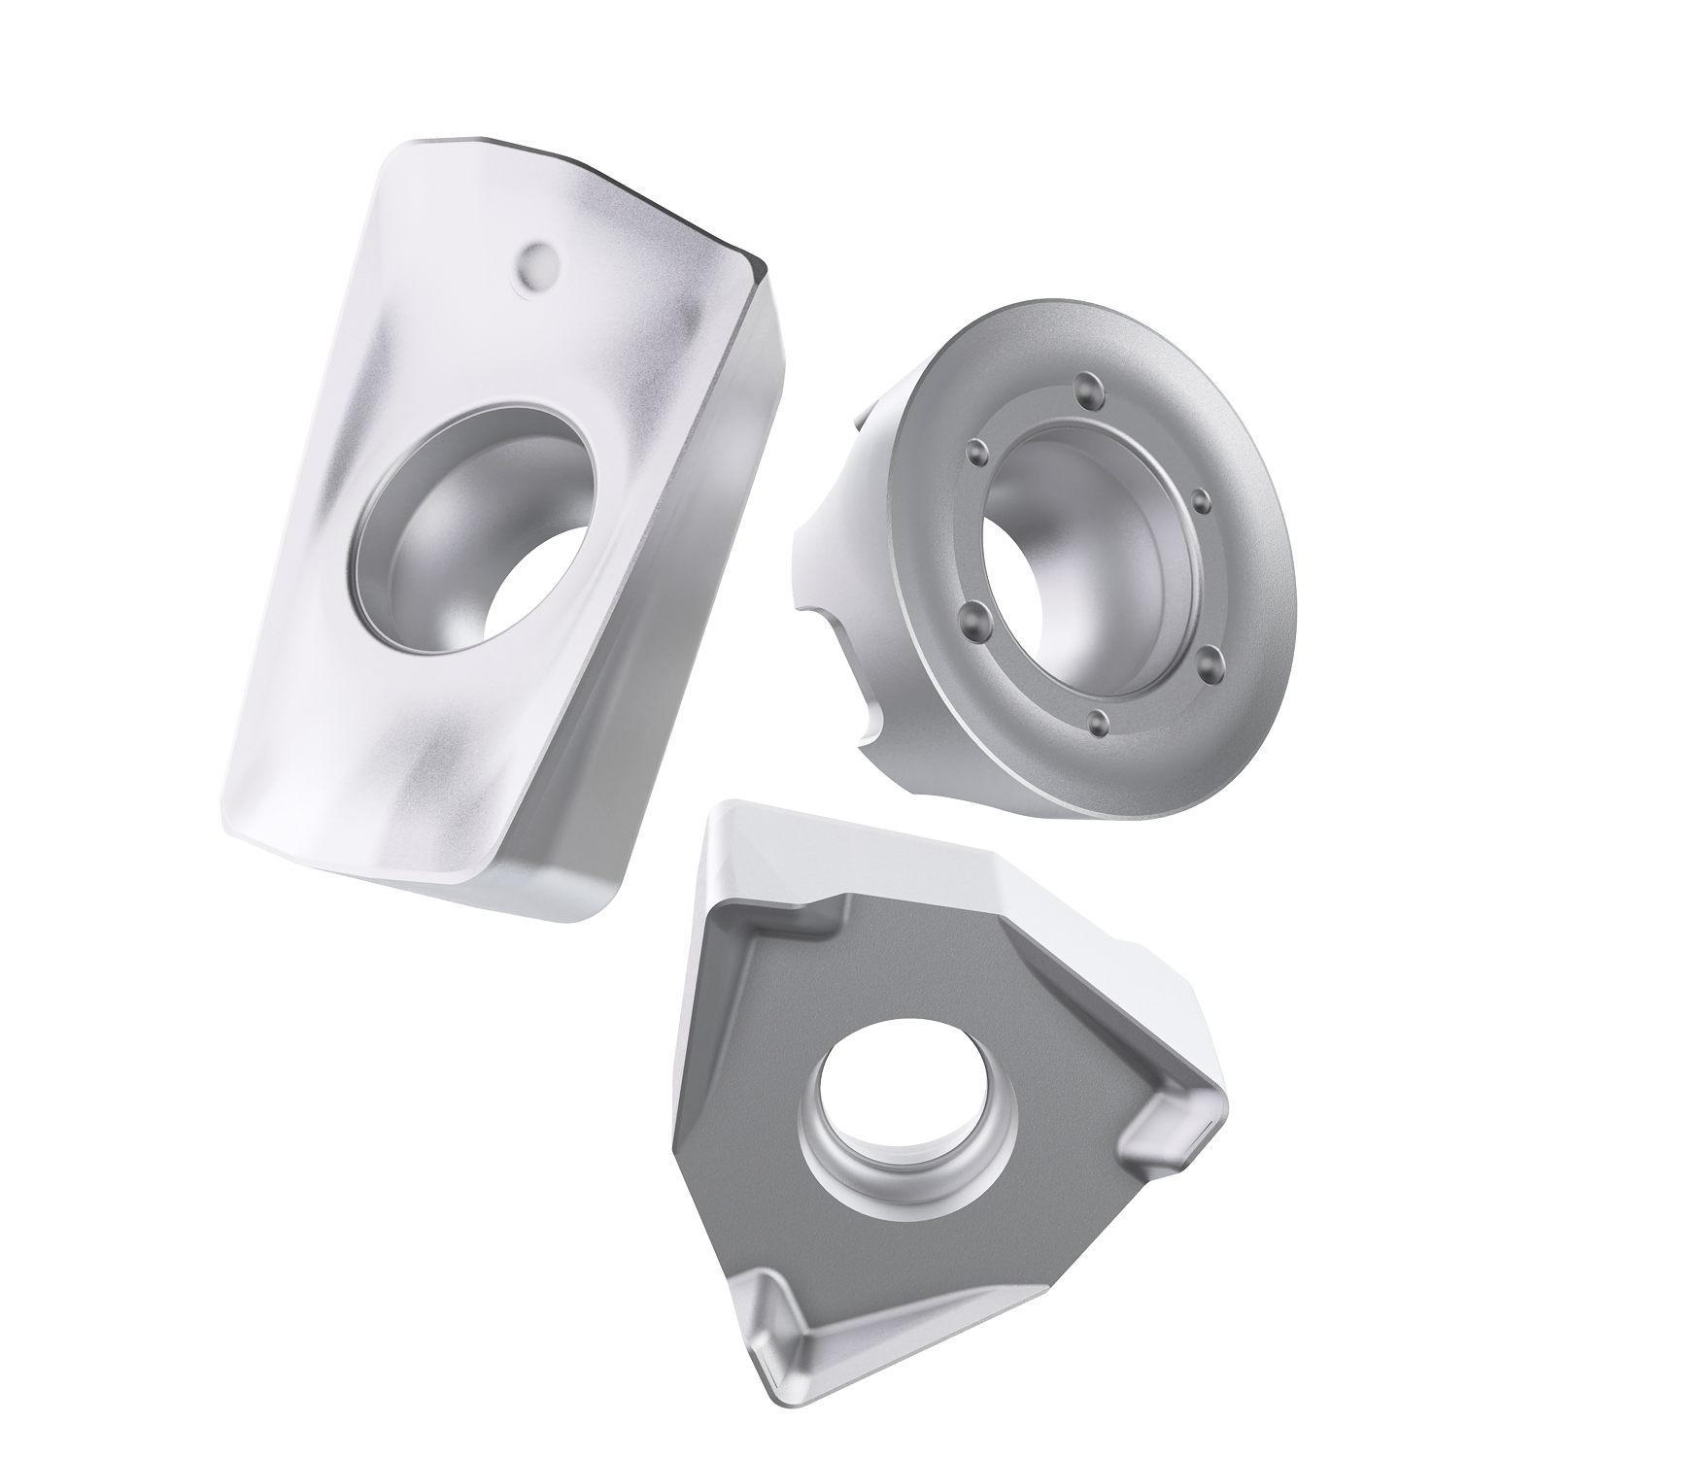
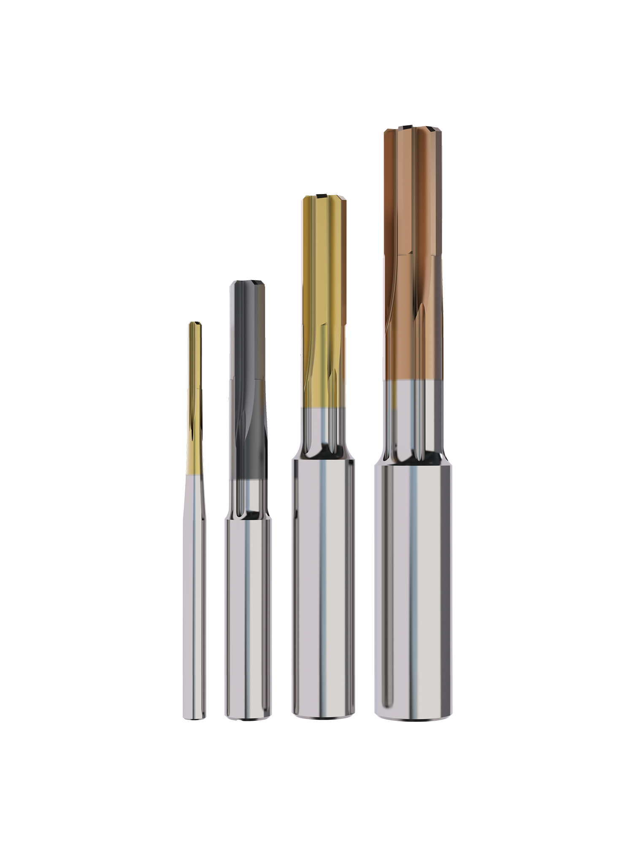
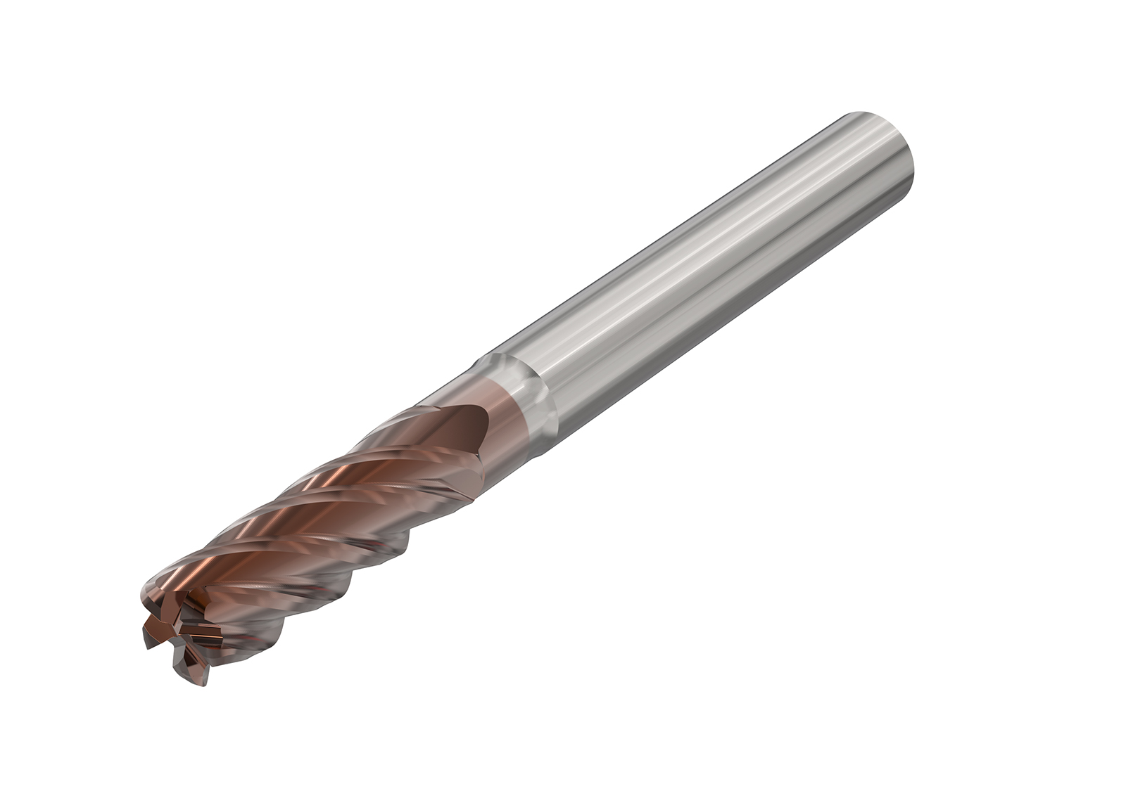
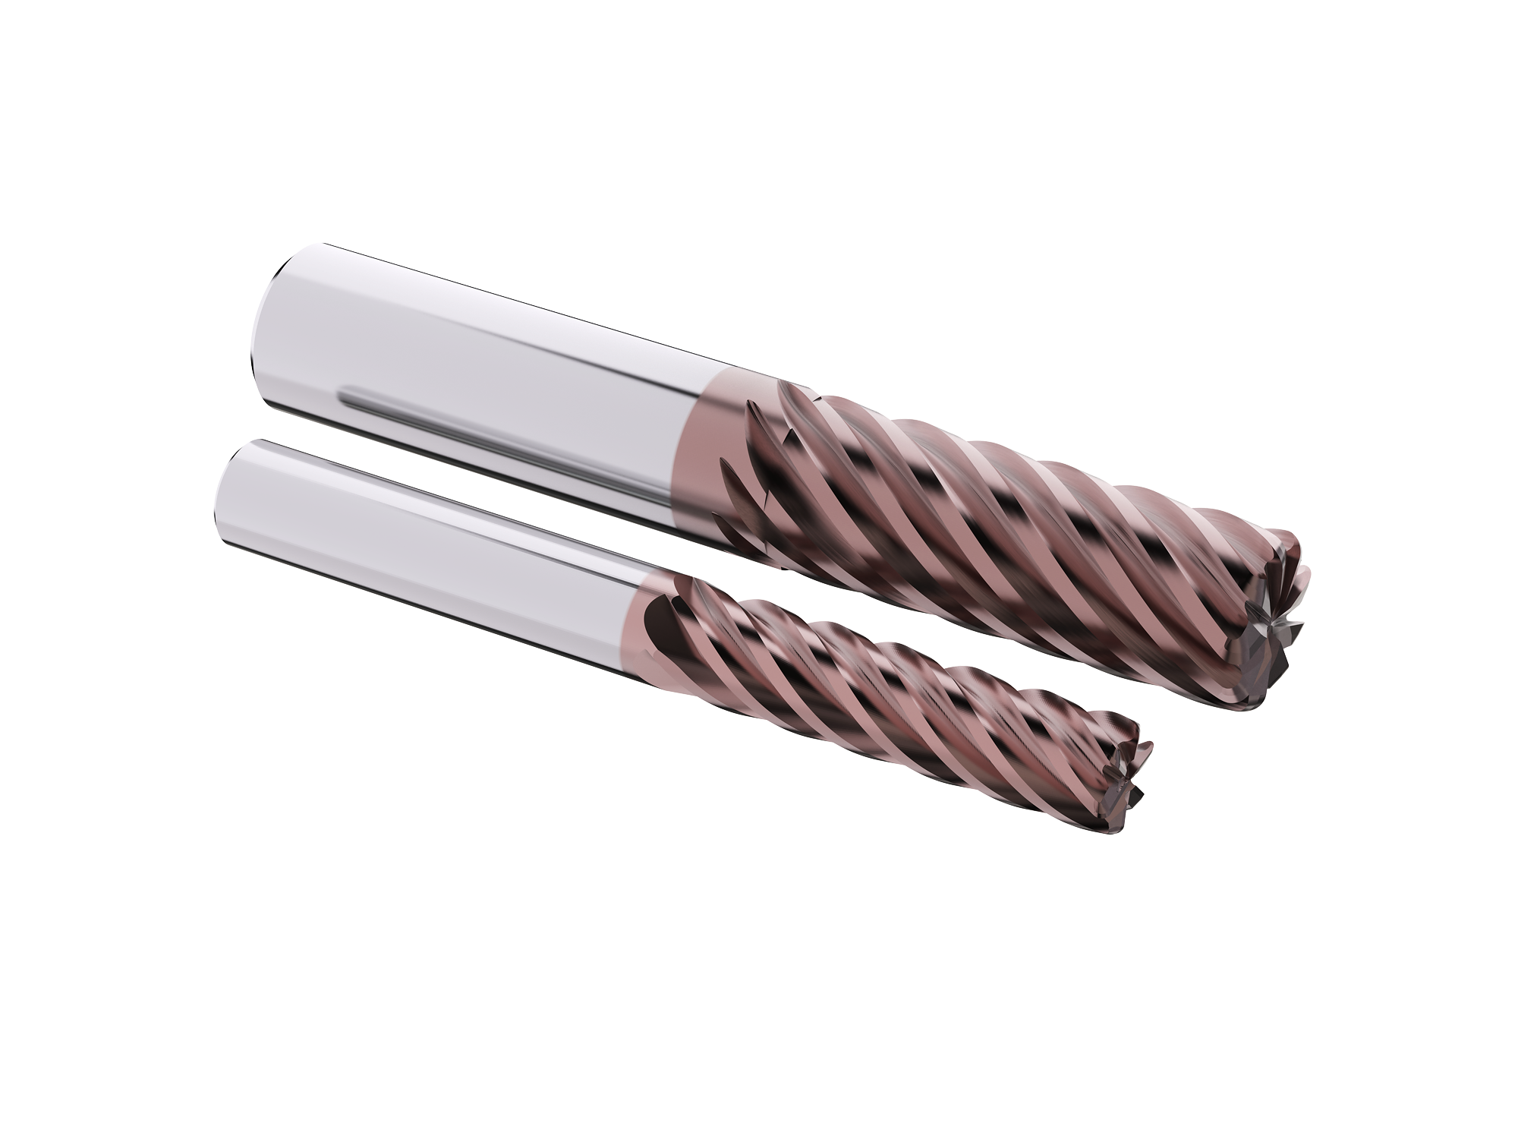
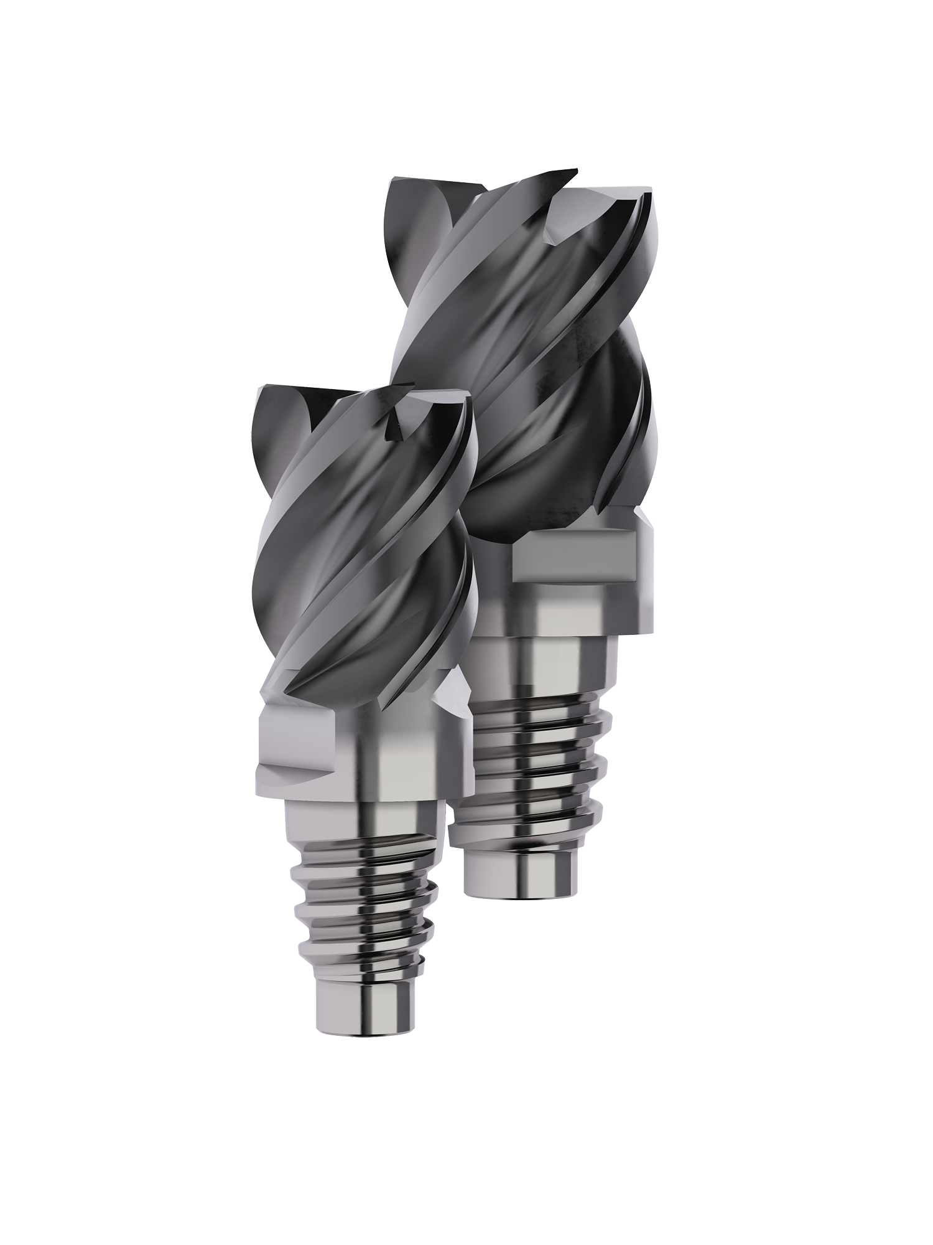
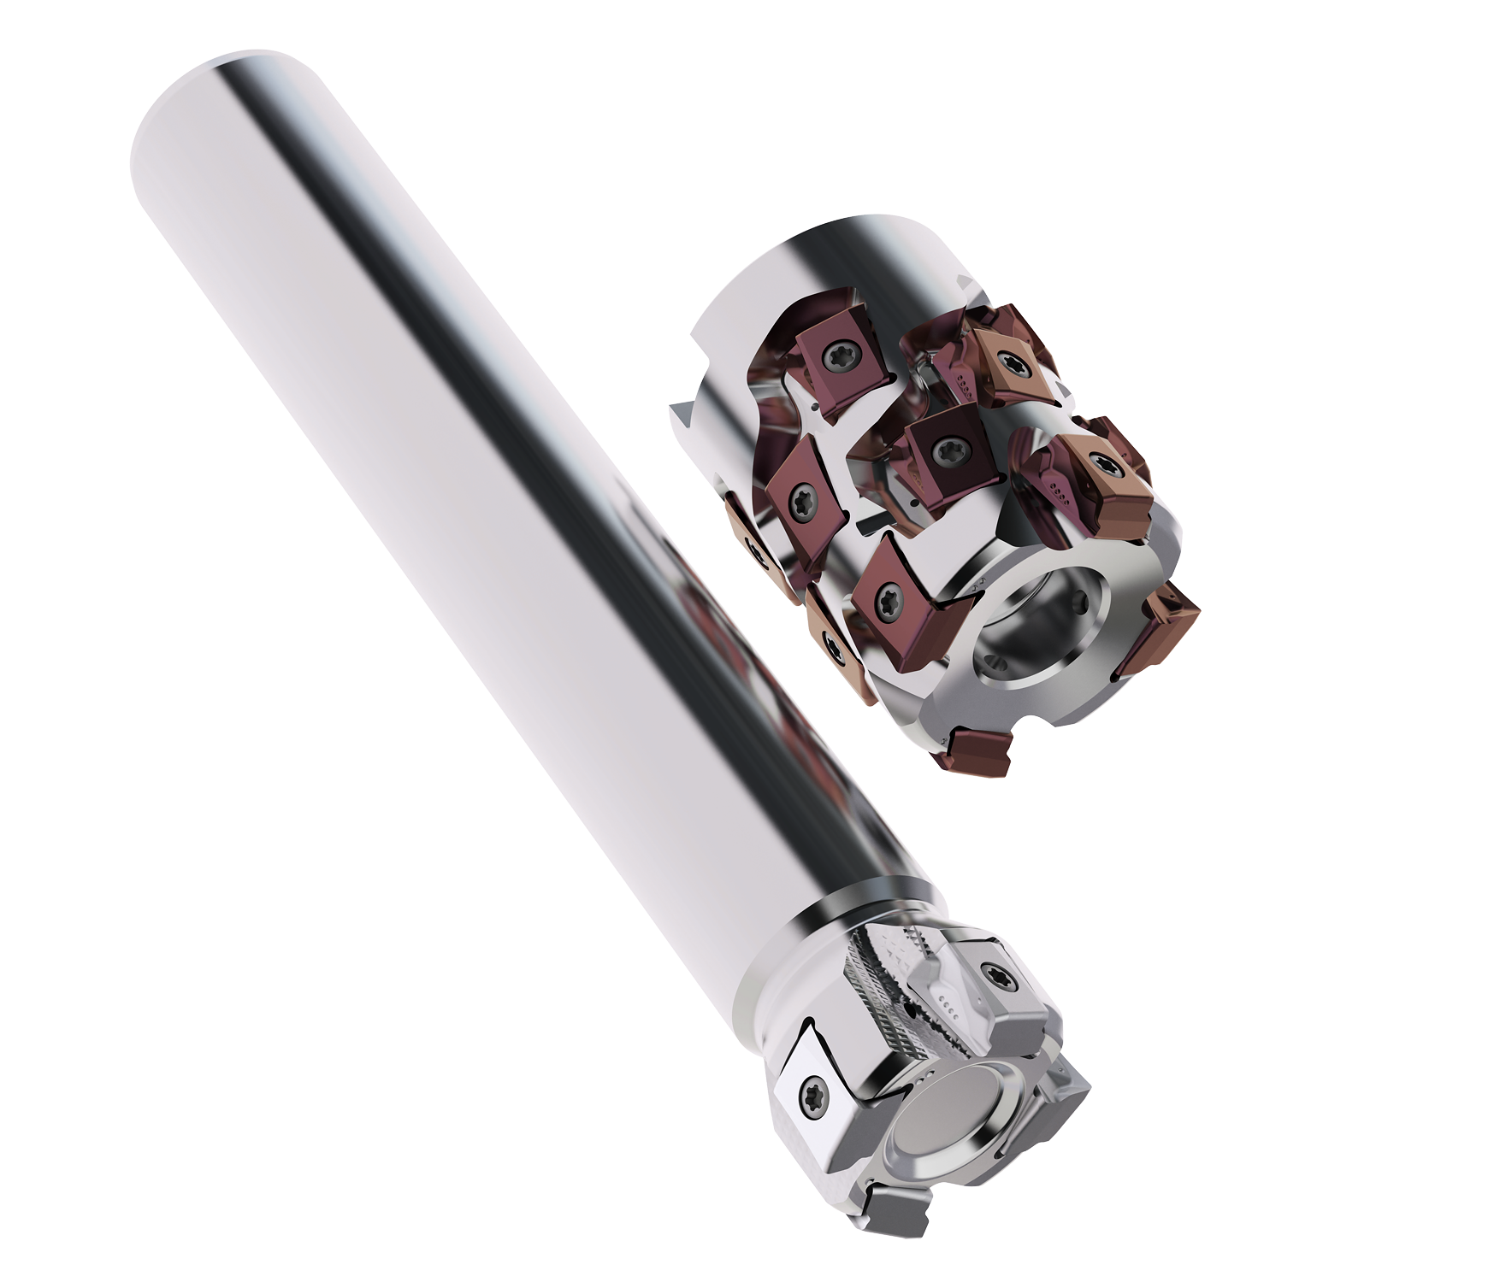
Launch 2024.1
MP3501
Nanojet reamers
JH730 addition
JS720 addition
X-heads additions
Square T4-12 Upgrade

Slide 5
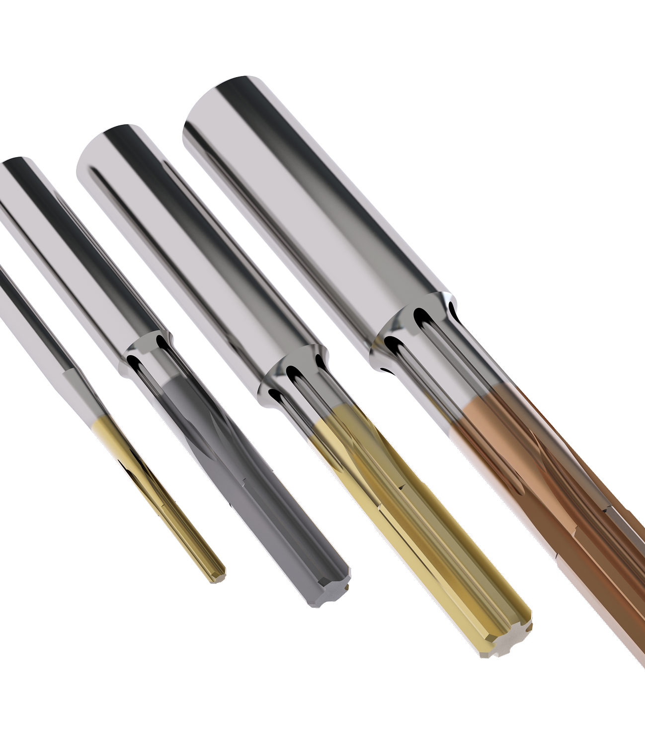
Nanojet reamers

Slide 6
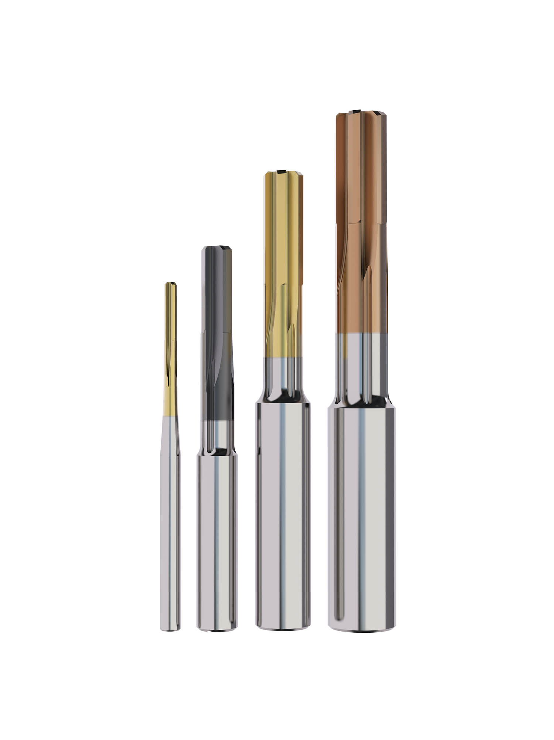
Introduction
Nanojet Product Launch 2024-1
Seco Nanojet Solid Carbide Reamers extend the high-quality performance of Seco Nanofix Reamers with an innovative coolant outlet to optimize chip control and tool life.
These versatile tools offer stable. reliable performance for fine reaming of blind and through bores in all materials and any precision toolholder.
They hold tolerances from 10 µm-15µm (0.0004"-0.0006“).
Nanojet Reamers are available in 8 grades and more than 10 lead geometries.

Slide 7
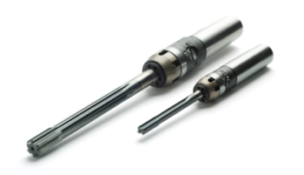
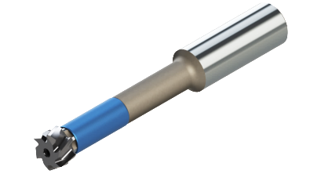
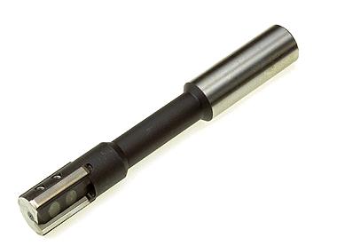
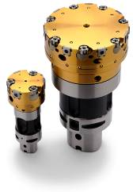
Non adjustable
Precimaster Plus
7.75- 60 mm
Nanofix
2.97-12 mm
NEW Nanojet
1.496-9.960 mm
Ø
Ø 1.5…………………………………………………………………………………………………………….…………………………………………………..155 mm
Bifix
7-60 mm
Xfix
40-155 mm
Adjustable
Notes:
Nanojet is part of the non—adjustable type reamers. Range starts at Ø1.496 and over laps with Precimaster Plus from Ø 7.75 to Ø 9.96.

Slide 8
Product Range
Nanojet Product Launch 2024-1
Ø 1.496 mm to 9.960 mm
5 - 7 x Ø (5XD short range launched SN2024.1)
  6 & 7 X D (standard range available by SN2024.2)
Most common H7 tolerance in stock 2 – 3 – 4 – 5 – 6 – 1/4” - 8
Any Ø and tolerances available in MyDesign (3-4 weeks until ready)
Suitable blind and through applications
3 versatile grades H15, RX2000, CP20
4 grades dedicated for M,N & S materials RN2010, RM2020, RM2090, RS2090
1 grade dedicated for K materials RK2050
Notes:
Automatic drawing generation is the issue. 3-4 weeks

Slide 9
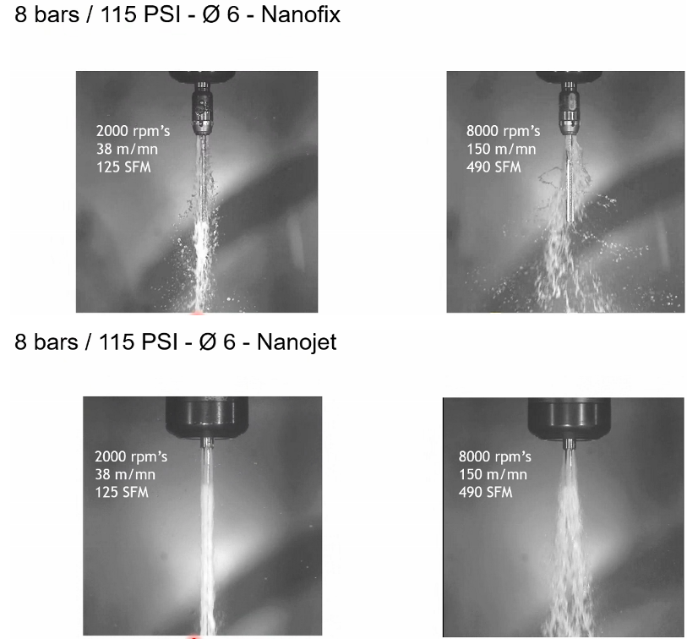
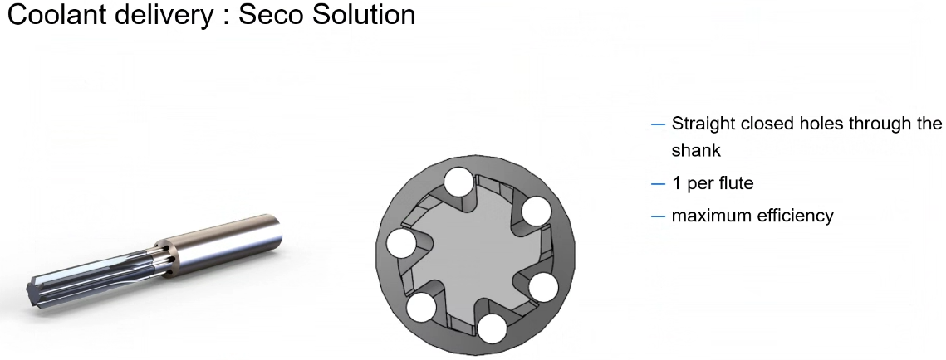
Nanojet product features
Nanojet Product Launch 2024-1
New innovative coolant outlet
Powerful & precise coolant jet directly to the cut
1 coolant channel per flute
Secure chip control & improve tool life

Slide 10
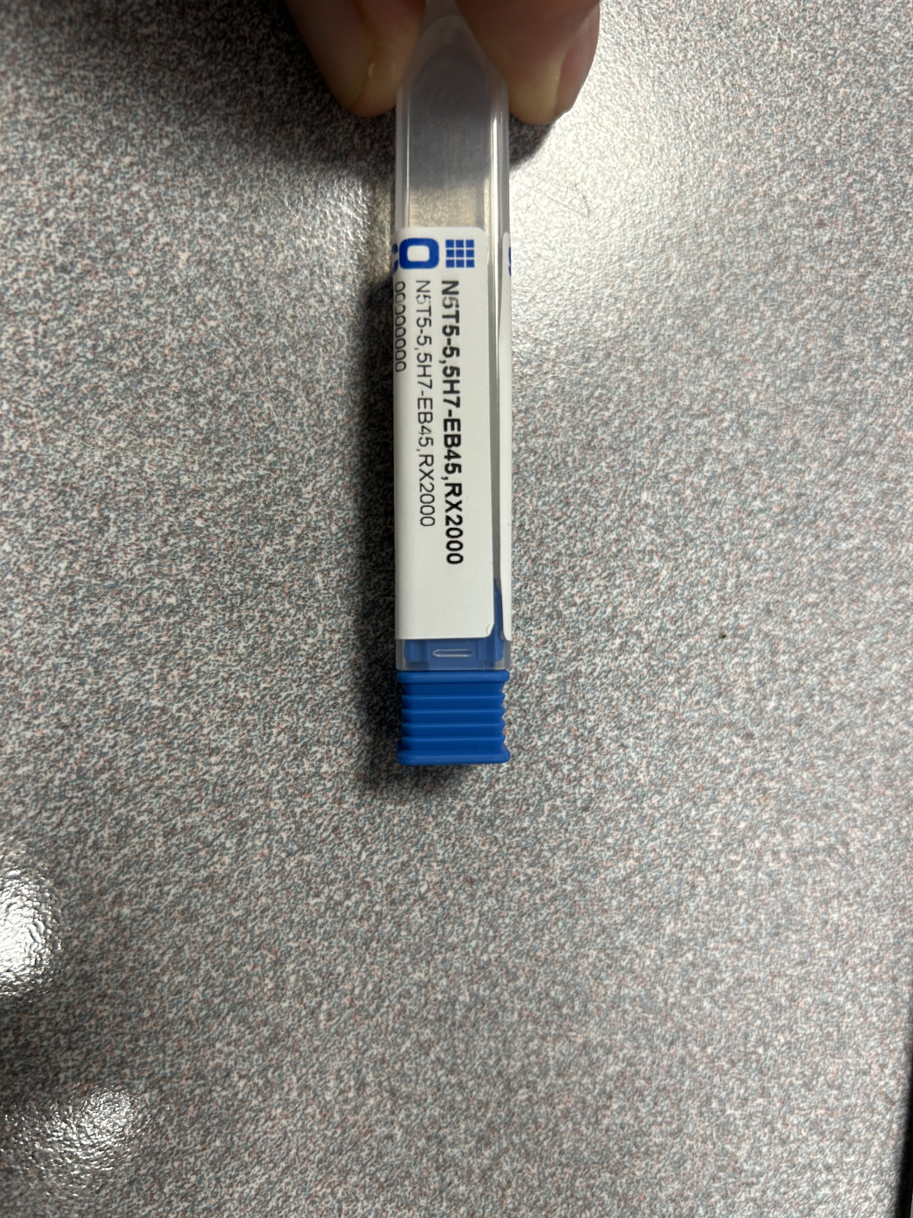
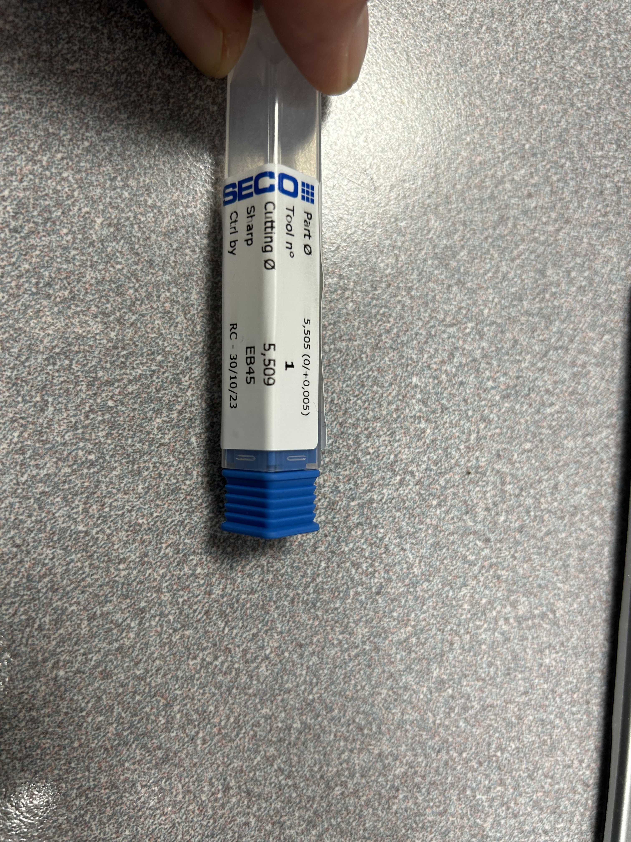
Nanojet product features
Nanojet Product Launch 2024-1
Documented inspection reports
Individual Inspection
Measured reamer Ø tagged on the box

Slide 11

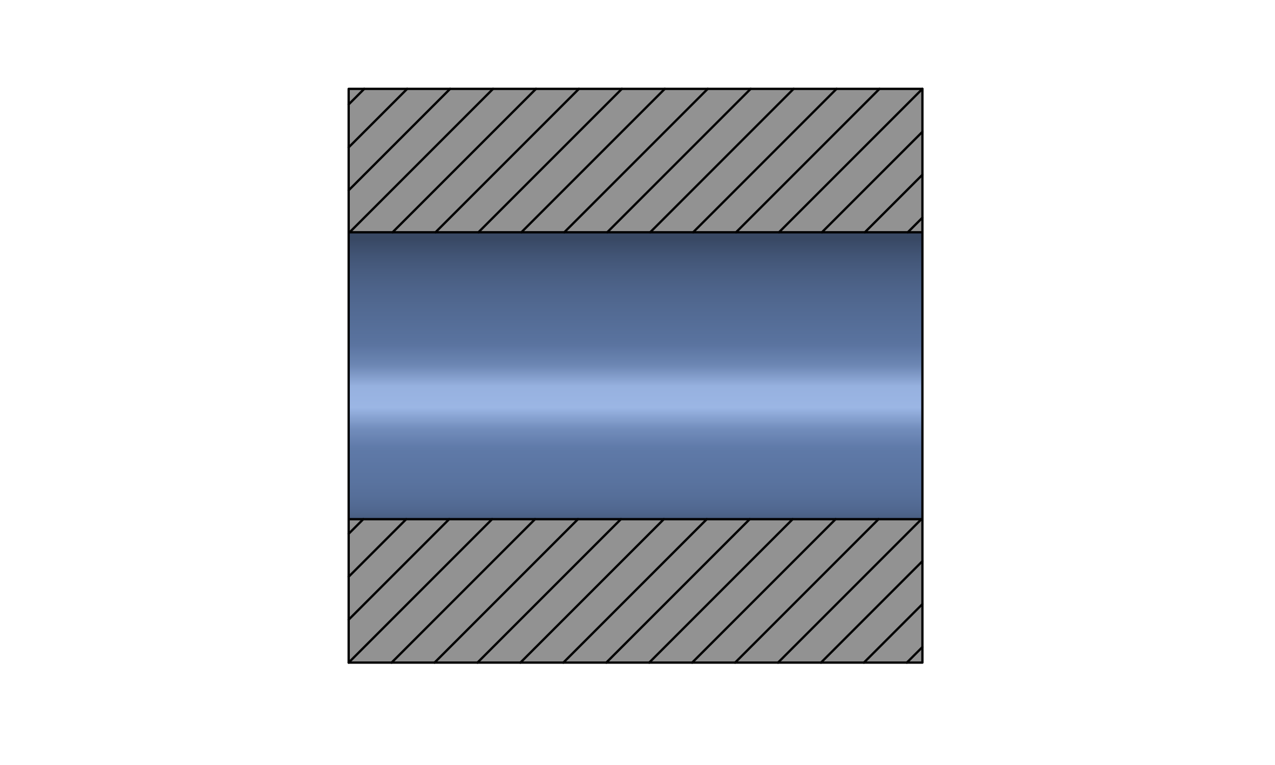
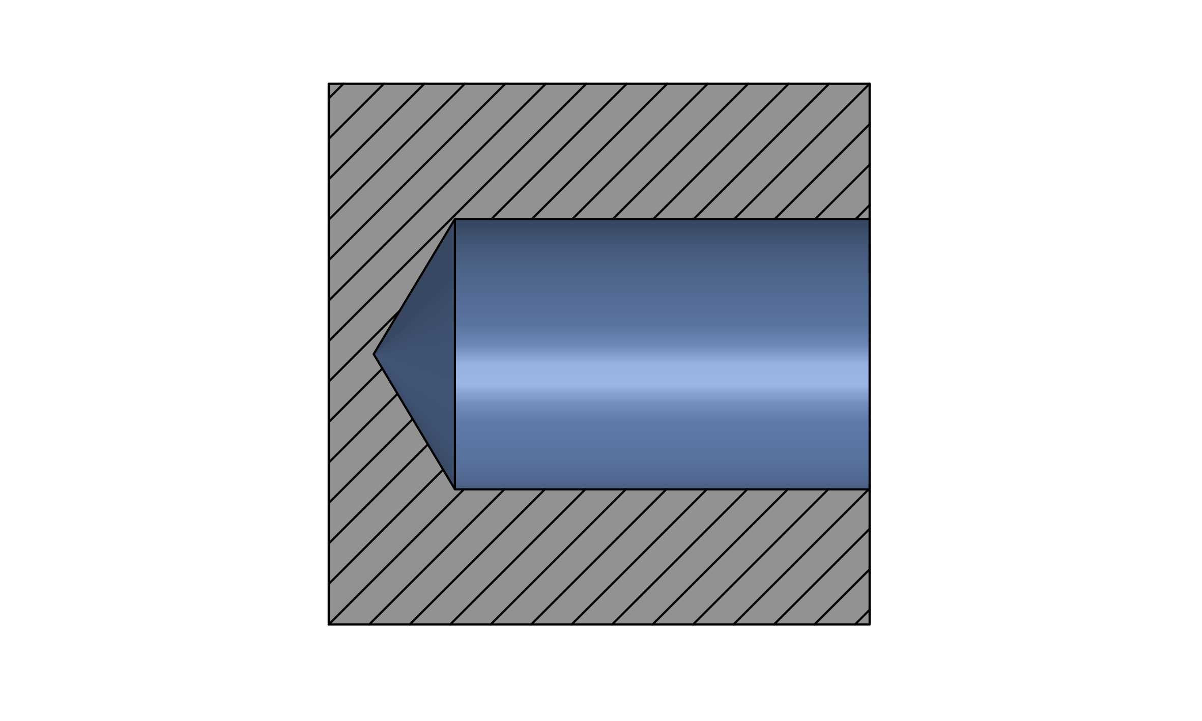
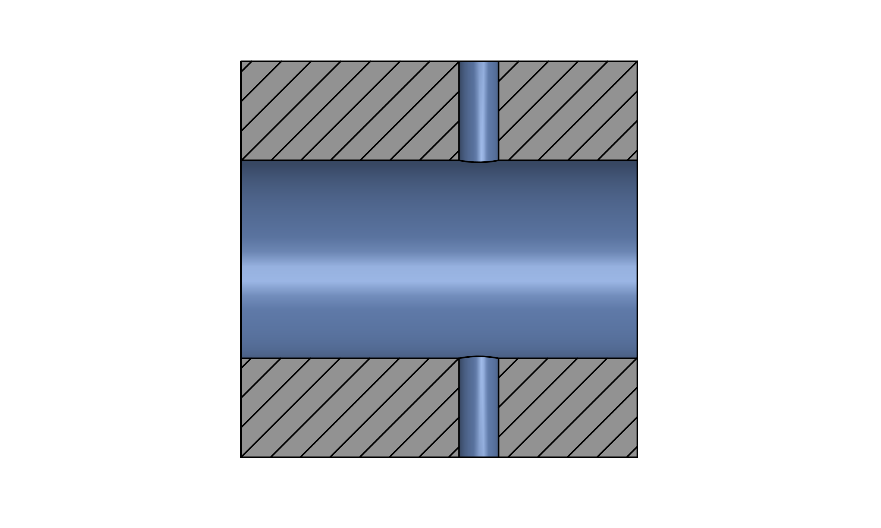
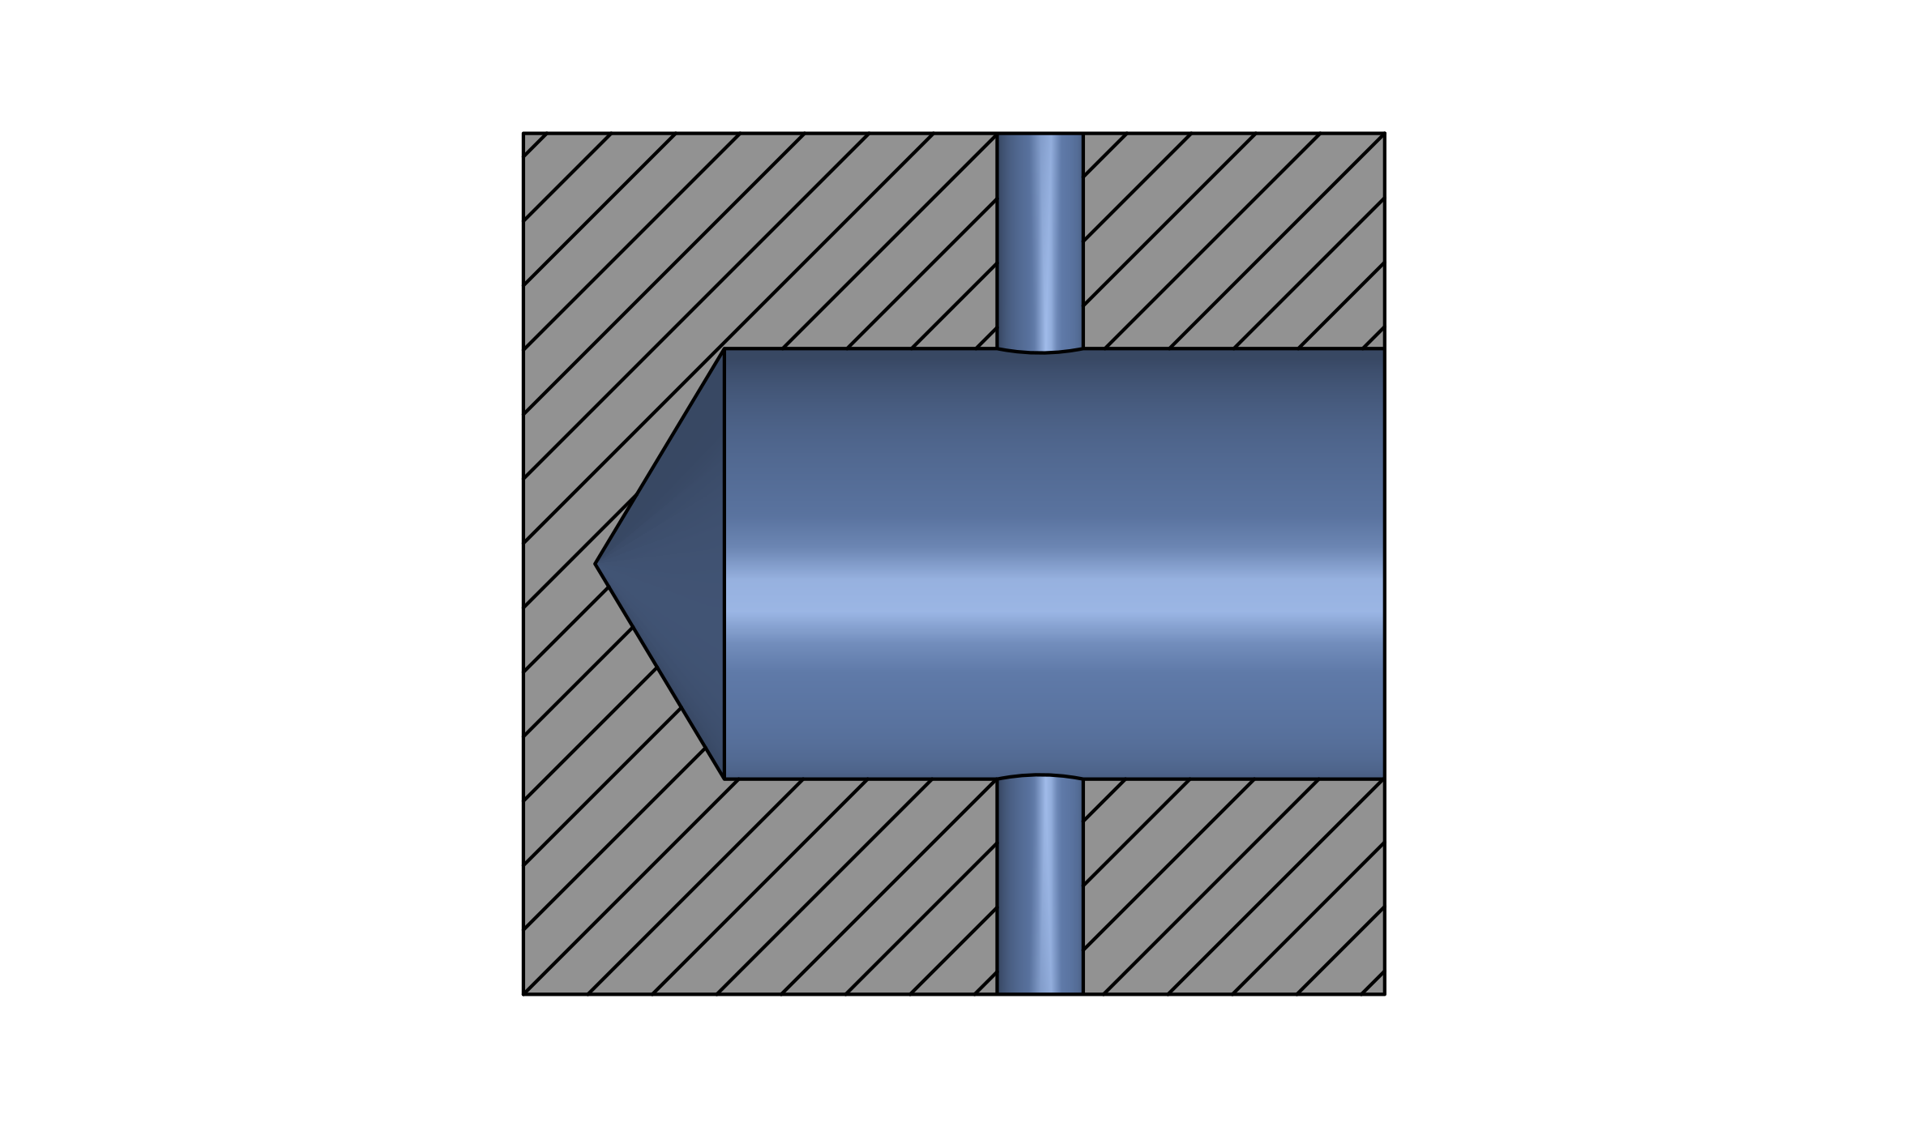
Applications
Nanojet Product Launch 2024-1
Through bores
Blind bores
Through bores crossing holes
Blind bores crossing holes

Slide 12
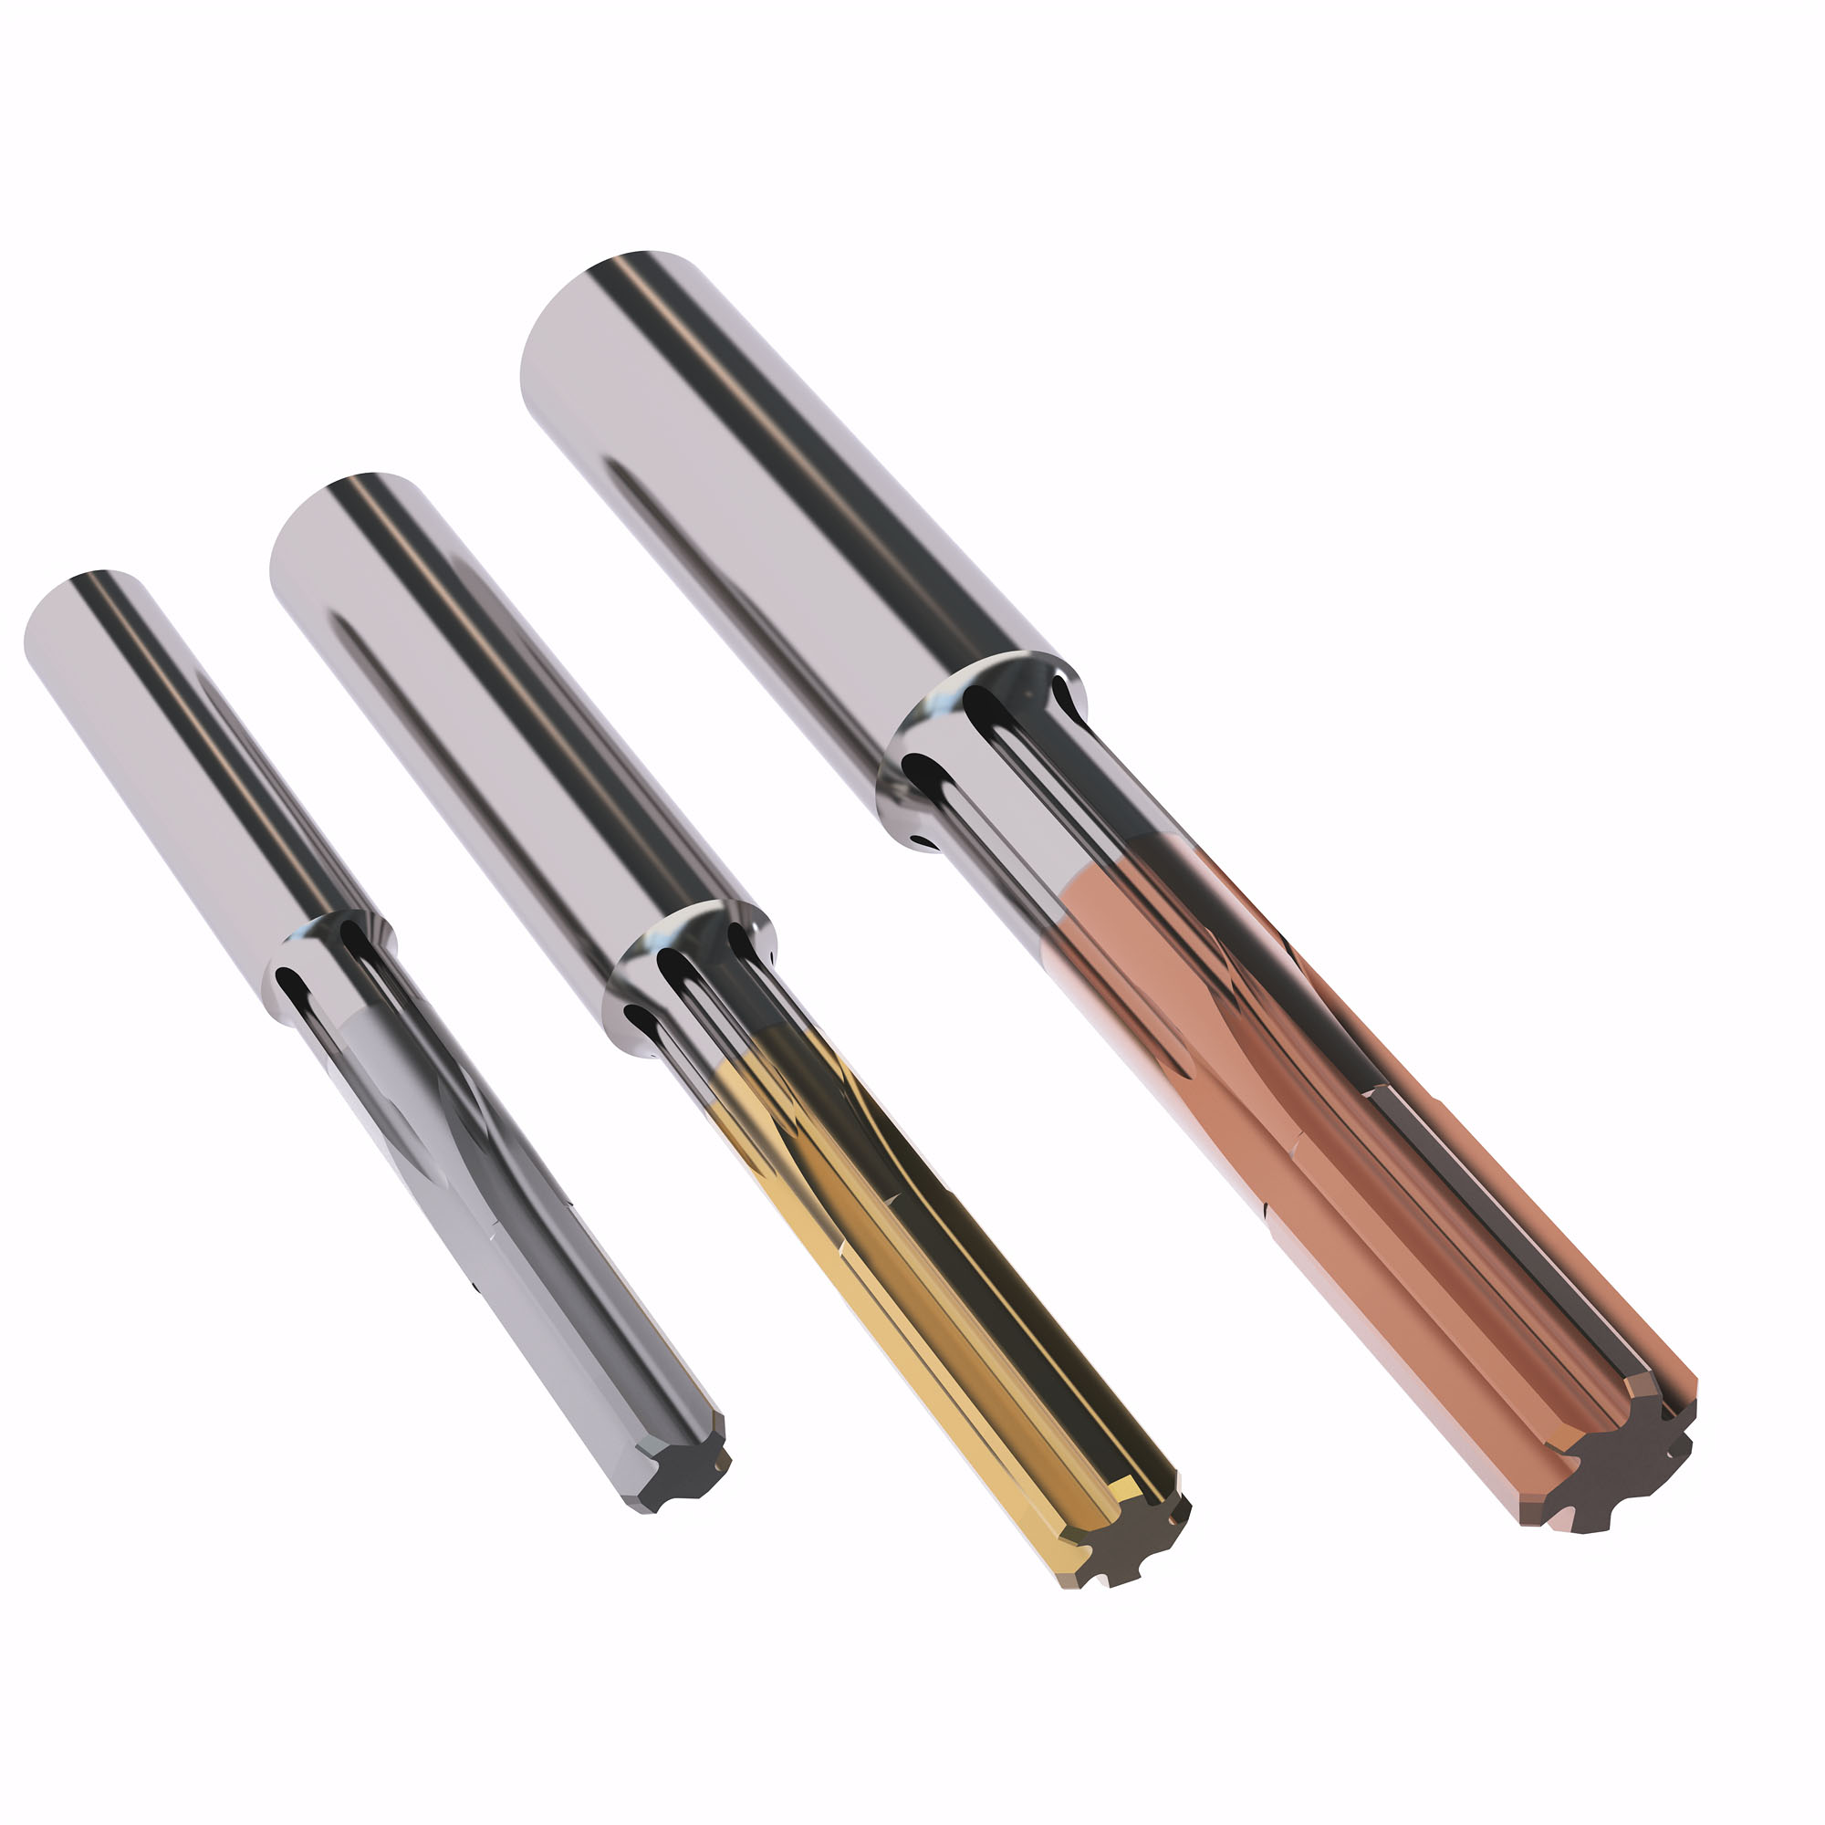
Nanojet product features
Nanojet Product Launch 2024-1
Multiple grades & geometries
8 grades
10 geometries
Applicable in all materials & all segments

Slide 13
Nanojet reaming grades
Nanojet Product Launch 2014-1
H
RX2000
CP20
RM2020
RM2090
RK2050
H15
RN2010
RS2090
P
M
K
N
S
  H15: Micrograin uncoated grade suitable for all materials
  RX2000 : High performance coated grade suitable for all materials
  CP20: Versatile coated grade suitable for most materials. exept aluminum
  RN2010: Micrograin. uncoated grade with optimized geometries for N materials
  RM2020: Though coated grade for fine reaming operation with optimized geometries for M materials
  RM2090: Wear resistant coated grade with optimized geometries for M materials. Optimization in M materials
  RS2090 : Wear resistant coated grade with optimized geometries for S materials. Optimization in S materials
  RK2050 : Tough coated grade suitable for fine reaming operation with optimized geometries for K materials

Slide 14
Code Key Nanojet
Nanojet Product Launch 2024-1
N5TS
-
5 H7
-
EB45
-
RX2000
5 means RHC
Family
Name
Coolant style
T = through
B = blind
Body length
S = short – 5xD
M = medium – 6xD*
L=long – 7xD*
*Soon to come*
Cutting Ø
min/MAX or ISO
Lead angle geometry
Grade
N5BS
-
7.990/8.005
-
EB30
-
RK2050

Slide 15
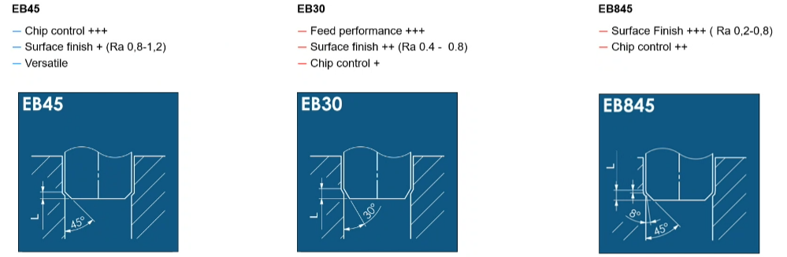
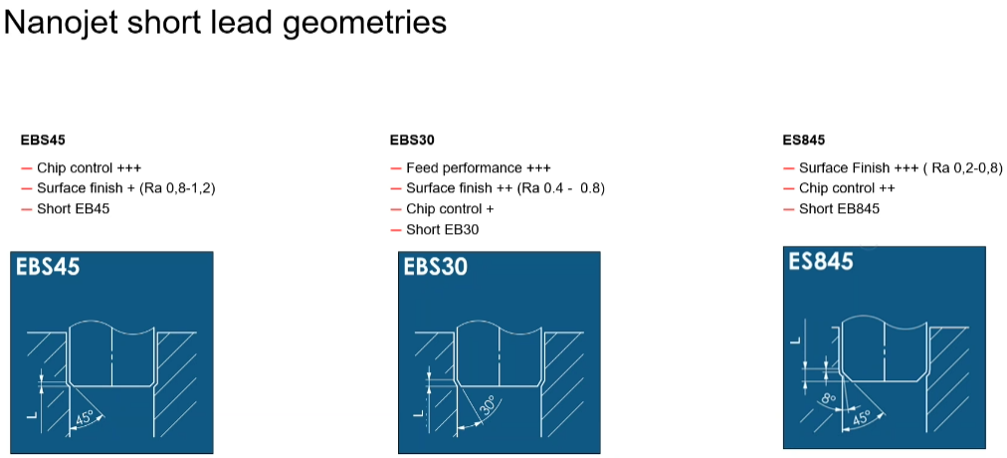
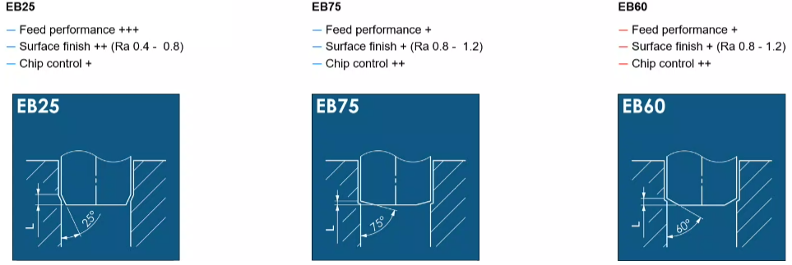
Tips & Tricks
Nanojet Product Launch 2024-1
EB45 lead geometry covers 85% of all applications
Tight surface finish tolerance with slight chip control EB845
EB75 relieves stress on the bottom of a hole
EB25 is for high feed in cast iron

Slide 16

Competition

Slide 17
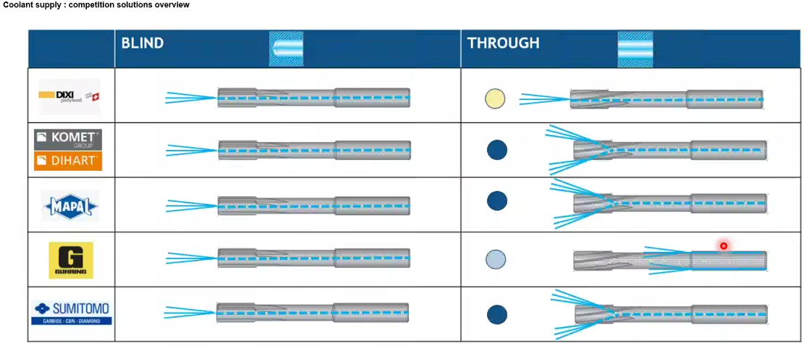
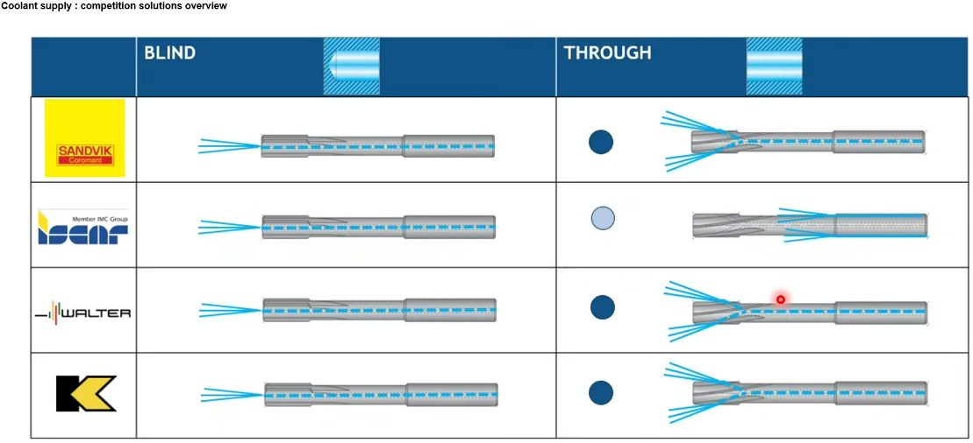
Nanojet: Competition
Nanojet : Competition
Notes:
There are many players on the market.
We are focusing on recognized pemium brands offering indexable system .
Here is Dihart . part of Komet group

Slide 18
FYI
Nanojet Product Launch 2024-1
6-8% coolant concentration is recommended for all reaming applications
Uncoated reamer tolerance is 3-4 micron
Coated reamers add 2-3 microns due to coating thickness (6-8 micron tolerance)
3 microns is 1/2 the dia. of a red blood cell
ISO temp for measuring is 20C (68F)
M, N & S grades have increased back taper and rake angle to cut more positive in Stainless steel, superalloys and non-ferrous materials (RM2020, RM2090, RS2090 & RN2010)

Slide 19
JH730 medical - addition

Slide 20
JH730 additions
Background
The JH730 is chosen when customers don't have 5-axis capability or the need for the JH780 Tapered ballnose
Further complement our offering in the medical segment
  Smaller diameters are missing in the range to fit the smaller inner radii of the box blend
  New dimensions to fit the requirements for finishing the Periphery and box on a femoral component

Slide 21
Seco medical range
Femoral machining
Product features
JH780
Our first standard TBN tool purposely desiging for 5-axis finish milling of the box walls. 2 flutes to centre offer excellent finishing capability including the cam and ‘pencil’ finish profiling on the cam/ box wall fillet radii.
JH722
With a short flute length which maximises stability and strength while offering a long reach at the same time. Tightly controlled radius tolerance means this is the perfect tool for finish profile milling of the condyle surface.
JH730
A tool designed for rough plunge milling the box corners and used to finish peripery mill the outside femoral surface. Unequal helix reduces vibrations with a long apmxs flute length.
JH724/JH726
Our first standard barrel tool purposely desiged for faster 5-axis finish milling of the condyle surface. The combination of specific tool features provides a well-balanced designed tool shape to perform several operations to machine femoral components.
JH721
Designed for productive machining of the condyle and box transition blend radius. Best grade fit combined with 6 flutes, 2 across the centre allow for multipule 2.5 and 3D semi-finishing and finishing operations.
JHP994
A tool designed for rough plunge milling the box corners and used to finish peripery mill the outside femoral surface. Unequal helix reduces vibrations with a long apmxs flute length.

Slide 22
JH730 range overview
Product range overview
Designation | Item number | Length Index | Tool Shape | DC | DMM | APMXS | OAL | LN | DN | RE | PCEDC | Cylindrical
 |  |  | mm | mm | mm | mm | mm | mm | mm | mm
JH730060E2R050.0Z5-HXT | 10217826 | 2 | E | 6 | 6 | 19 | 65 | 25 | 5.7 | 0.5 | 5 | n
JH730060E2R100.0Z5-HXT | 10217827 | 2 | E | 6 | 6 | 19 | 65 | 25 | 5.7 | 1 | 5 | n
JH730060E2R150.0Z5-HXT | 10217828 | 2 | E | 6 | 6 | 19 | 65 | 25 | 5.7 | 1.5 | 5 | n
JH730075F2R050.0Z6-HXT | 10217829 | 2 | F | 7.5 | 8 | 24 | 63 |  |  | 0.5 | 6 | n
JH730075F2R100.0Z6-HXT | 10217830 | 2 | F | 7.5 | 8 | 24 | 63 |  |  | 1 | 6 | n
JH730075F2R150.0Z6-HXT | 10217831 | 2 | F | 7.5 | 8 | 24 | 63 |  |  | 1.5 | 6 | n
JH730080D2R050.0Z6-HXT | 03127375 | 2 | D | 8 | 8 | 25 | 63 |  |  | 0.5 | 6 | n
JH730080D2R100.0Z6-HXT | 03127377 | 2 | D | 8 | 8 | 25 | 63 |  |  | 1 | 6 | n
JH730080D2R150.0Z6-HXT | 03127378 | 2 | D | 8 | 8 | 25 | 63 |  |  | 1.5 | 6 | n
JH730080D2R200.0Z6-HXT | 03127379 | 2 | D | 8 | 8 | 25 | 63 |  |  | 2 | 6 | n
JH730100D2R100.0Z7-HXT | 03127380 | 2 | D | 10 | 10 | 31 | 72 |  |  | 1 | 7 | n
JH730100D2R250.0Z7-HXT | 03127381 | 2 | D | 10 | 10 | 31 | 72 |  |  | 2.5 | 7 | n

Slide 23
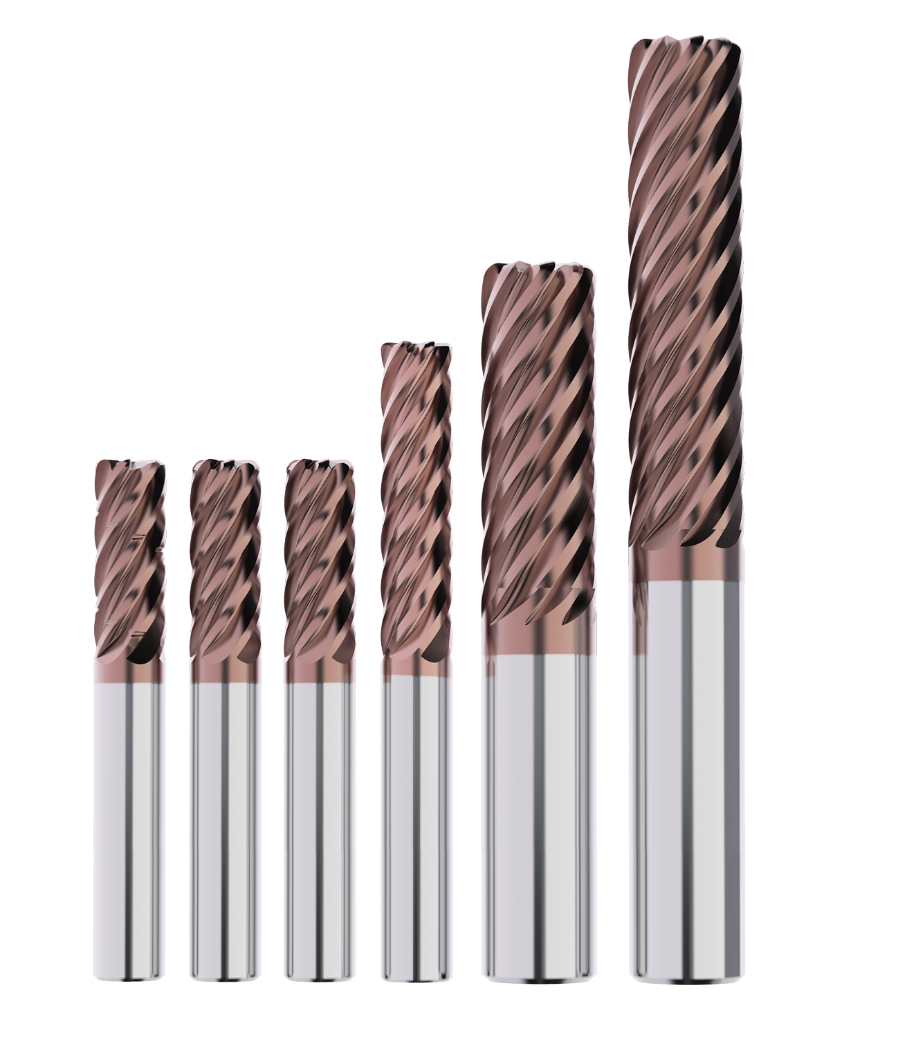
JS720 - addition

Slide 24
JS720 - addition
What it is and what does it?
Multi-flute tool for advanced roughing and finishing applications in ISO S materials.
Why has it been developed?
Increasing market demand in ISO-S materials (aerospace)
Which problem does it solve?
Rough, semi-finish and finish with one tool
New range additions: 88 total
6 flute without chipsplitters
  58 new items
6 flute with chipsplitters
  21 new items
9 flute
  9 new items

Slide 25
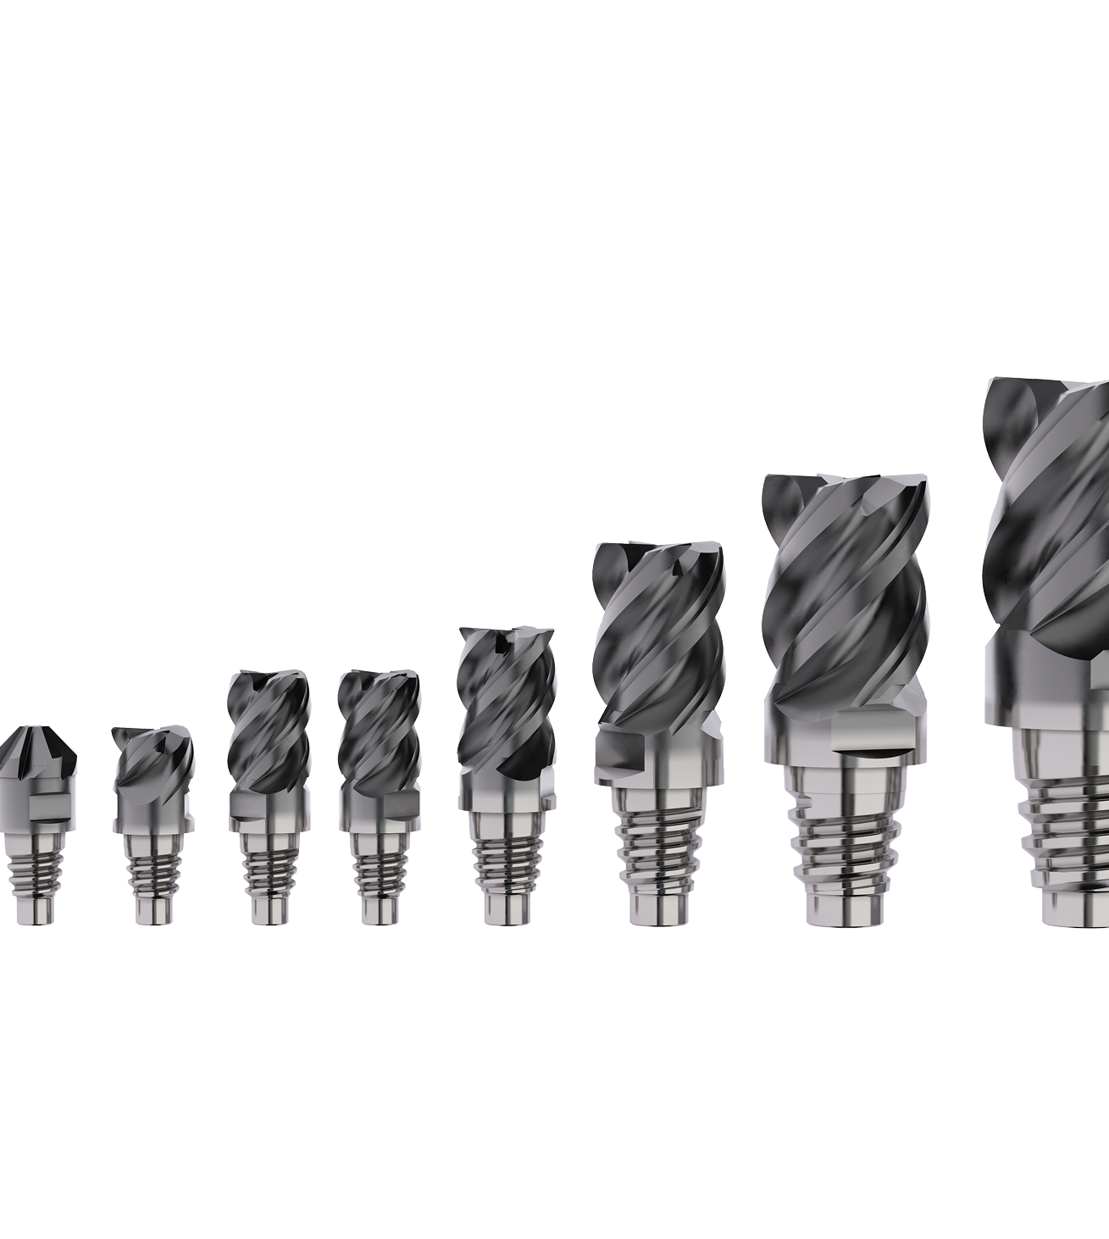
X-heads - addition

Slide 26
X-heads addition
What it is and what does it?
Exchangeable heads range additions
  XSE55X and XSC509 Chamfer heads
  6 added shanks in E25 connection
Why has it been developed?
Fills gaps in XSE55X family
Multi-flute chamfer for added productivity.
Added shanks to increase product flexibility. Focus on E25 connection.
Which problem does it solve?
Added selection for versatility
Long reach applications
New range additions:
XSE550 Series
  3 and 4 flute
  Added Chamfer and radii variants
  Added DC Ø25mm items
Shank additions
  Connection size E25
  Steel, Densimet and Carbide shanks

Slide 27
SN1:2024 Additions Shanks
Designation | Length Index | Tool Shape | CZCWS | DCSFWS | DMM | LF | OAL | BHTA | Cylindrical
Inch Additions
XE251.00E2-4.50-00.0S | 2 | E | E25 | 24.4 (0.96") | 25.4 (1.0") | 38.1 (1.5") | 114.3 (4.5") | - | Yes
XE251.25J2-7.50-05.0S | 2 | J | E25 | 24.4 (0.96") | 31.75 (1.25") | 42 (1.65") | 190.5 (7.5") | 5 | Yes
XE251.25J2-8.50-05.0E | 2 | J | E25 | 24.4 (0.96") | 31.75 (1.25") | 42 (1.65") | 215.9 (8.5") | 5 | Yes
XE251.00E2-7.28-00.0DM | 3 | E | E25 | 24.4 (0.96") | 25.4 (1.0") | 65 (2.56") | 185 (7.28") | - | Yes
Metric Additions
XE25320J2-190-05.0E | 2 | J | E25 | 24.1 | 32 | 45.1 | 190 | 5 | Yes
XE25320J2-215-05.0E | 2 | J | E25 | 24.1 | 32 | 45.1 | 215 | 5 | Yes

Slide 28
Questions?

Slide 29
Thank you!

