Slide 1
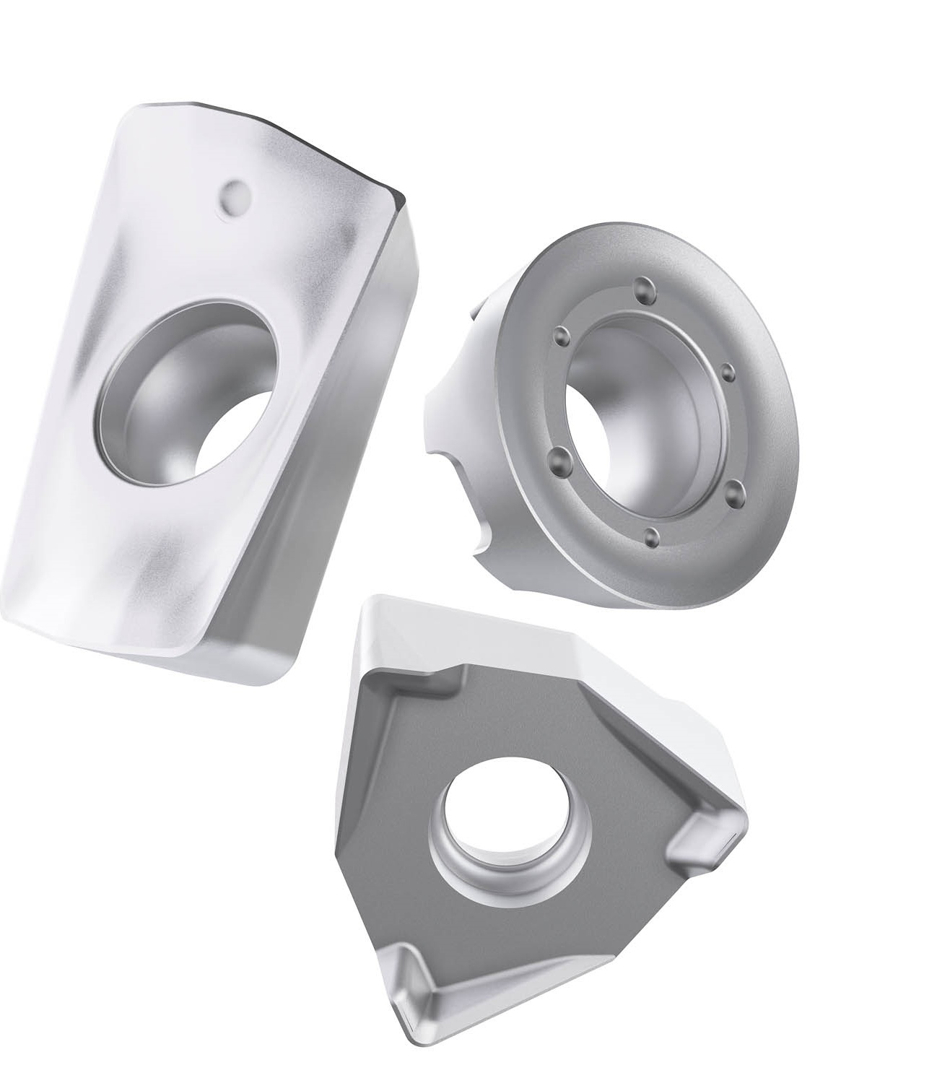
MP3501 Duratomic Steel Milling Grade
SN2024.1 Completing the MP Grade Family

Slide 2
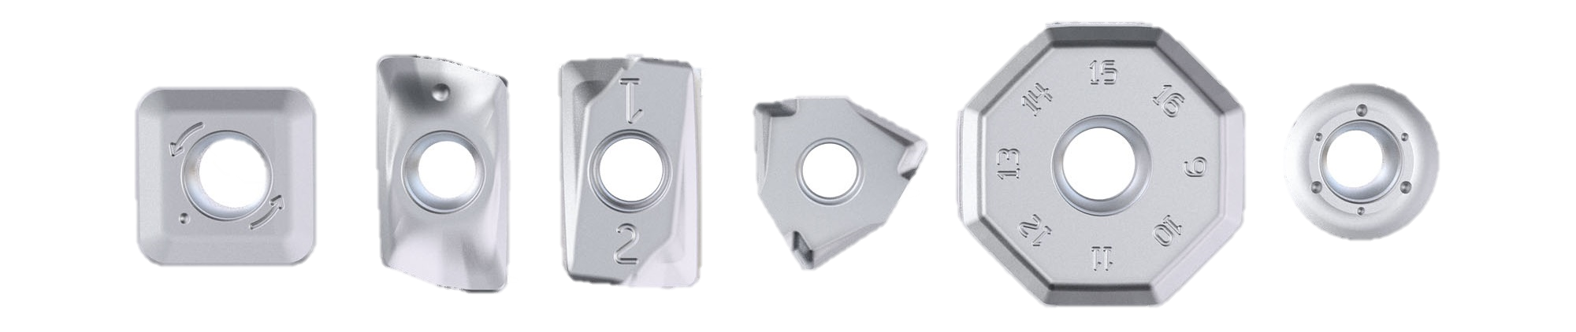
A Brief Overview of the Duratomic Family
SN2024.1 MP3501 Product Introduction
2007 Release of the original Seco Duratomic
MP1500 & MP2500
2019 Release the new Seco Duratomic
MP1501 & MP2501
2024 Launch of the new MP3501

Slide 3
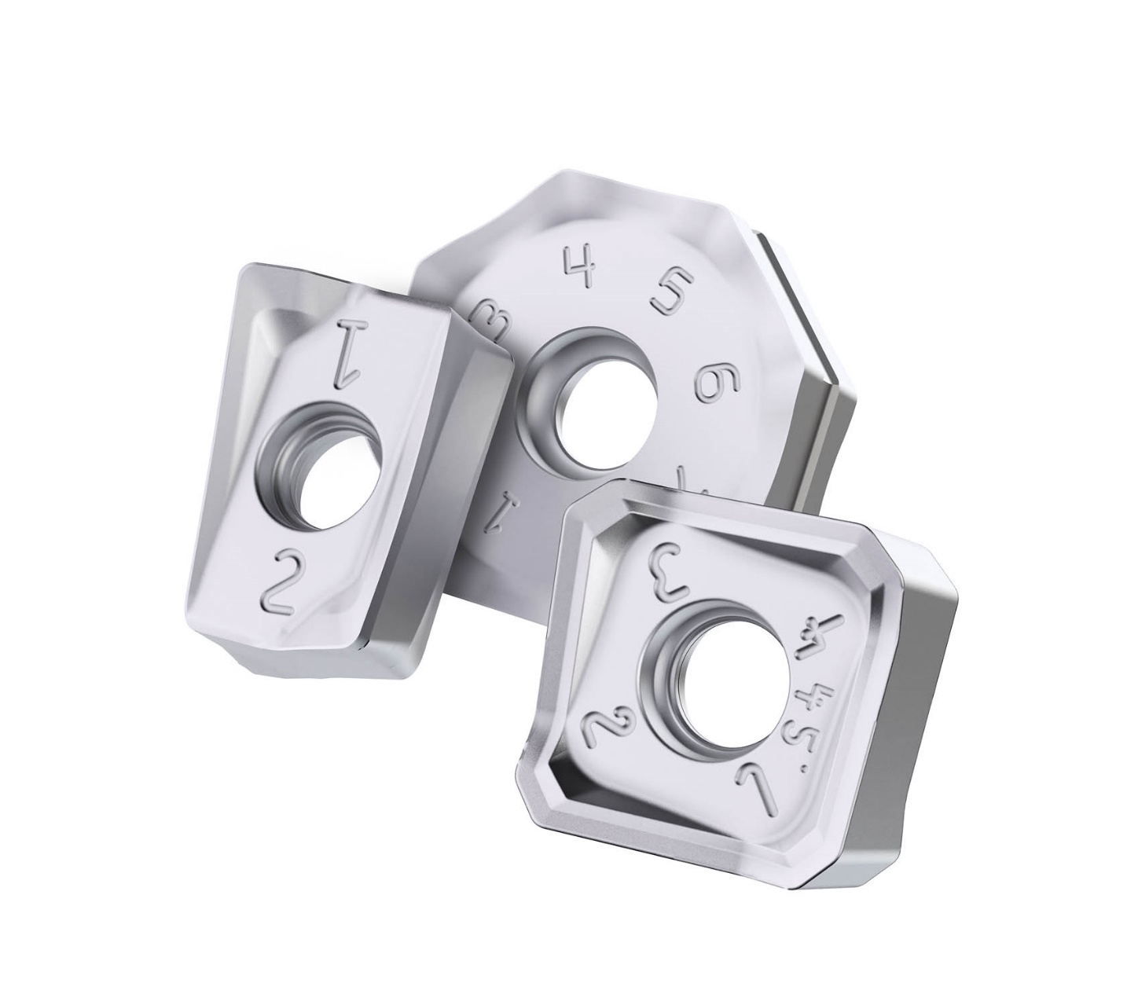
MP3501 Customer Benefits
SN2024.1 MP3501 Product Introduction
Replacement for T350M
Complete MP Grade Family
Easily identify used edges
Tough and reliable
Reduce inventory
α-Al₂O₃
Bonding layer
Ti(C,N)

Slide 4
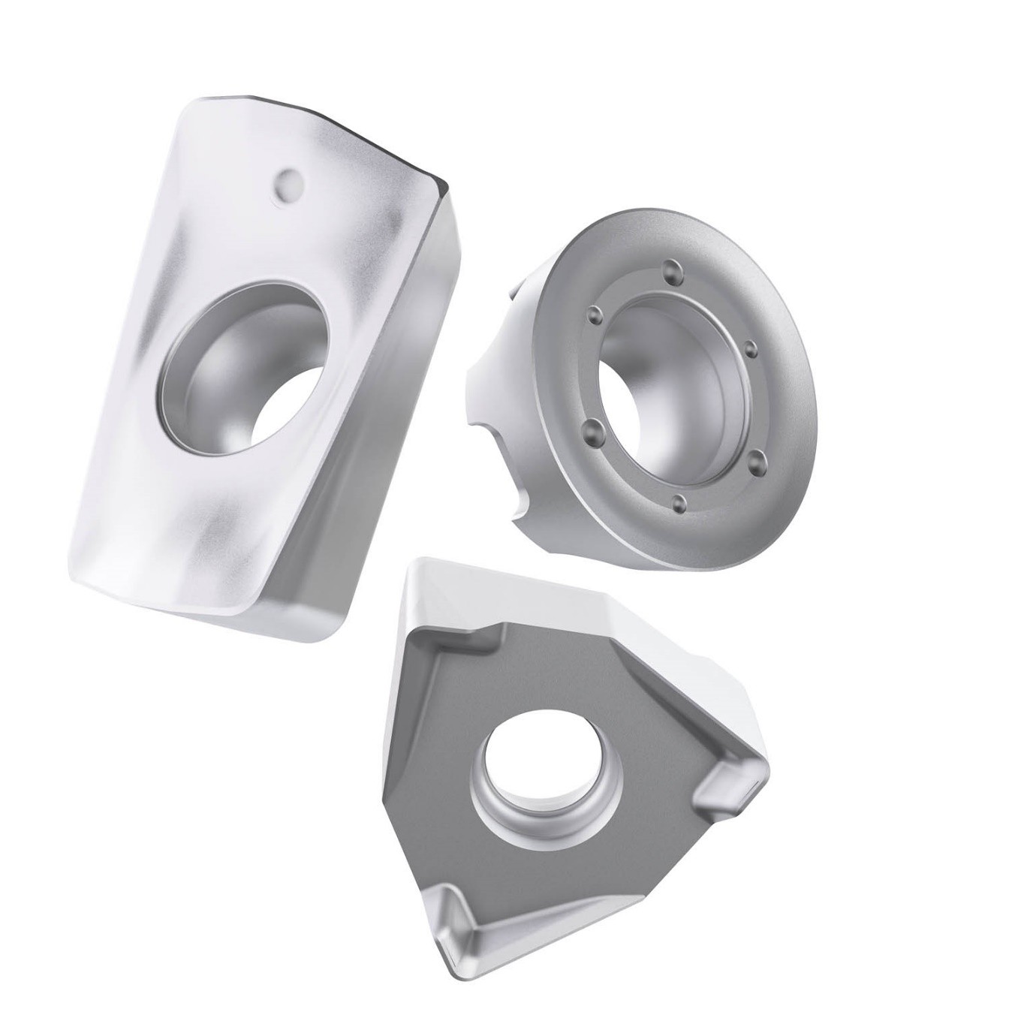
MP Family Application Range
SN2024.1 MP3501 Benefits
2. Better alignment + bigger overlap
MPx501
1. Increased toughness – working window
MPx500
Increased versatility thanks to a wider working window and a better alignment will give you the ability to machine a larger selection of materials with a smaller range of grades.
MP1501
MP2501
MP1500
MP2500
MP3501
Thermal resistance – v_{c} capability
T350M
Toughness – f_{z} capability – vibrations

Slide 5
MP Family Material Recommendations
SN2024.1 MP3501 Benefits
MP1501
MP2501
MP3501
High productivity in steel and ductile cast iron
Versatile productivity in steel and stainless steel
Versatile productivity in steel, stainless steel and cast iron
P
K
P
M
P
M
K

Slide 6
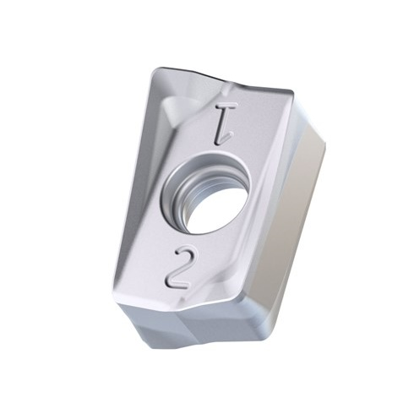

MP3501 & Sustainability
SN2024.1 MP3501 Benefits
30% recycled carbide content
Seco improving our environmental footprint
Supporting our customer’s sustainability goals

Slide 7
MP3501 Benefits Summary
SN2024.1 MP3501 Overview
Increase your profits with smooth, secured unattended production.
Production that runs smoothly, with predictable results and without unexpected interruptions,
enables secure unattended production and high machine utilization.
Reduce your inventory and costs.
High versatility and wide application window will make your choice and handling easier.
The flexibility of this grade chain makes it suitable for both wet and dry machining.
Improved tool life that reduces your costs
Without changing cutting data, the tool life will increase by 20-30%.
Eliminate waste & improve sustainability
Don’t throw away any unused edges thanks to the used-edge detection.
The up to 30% recycled material in the substrate supports sustainability goals of circularity.

Slide 8

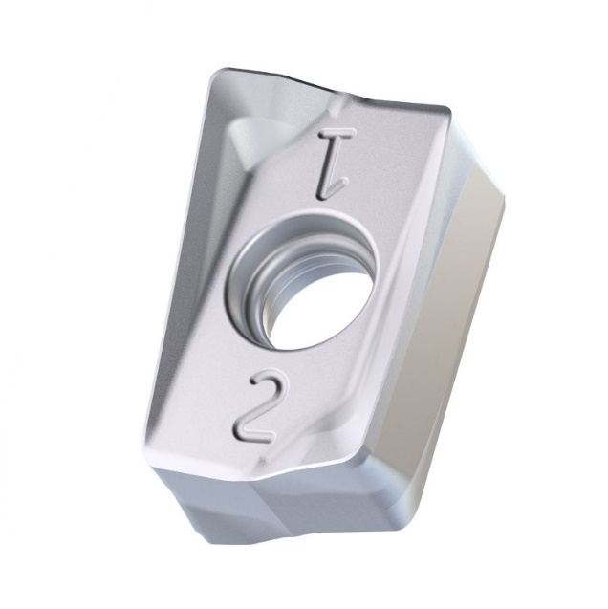
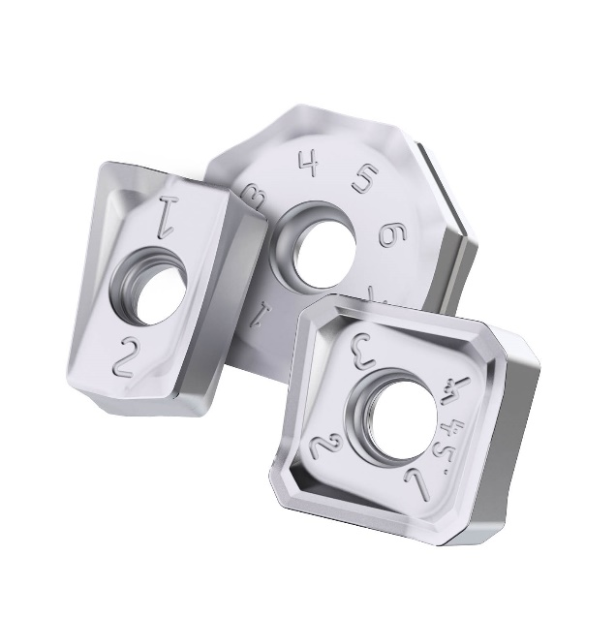
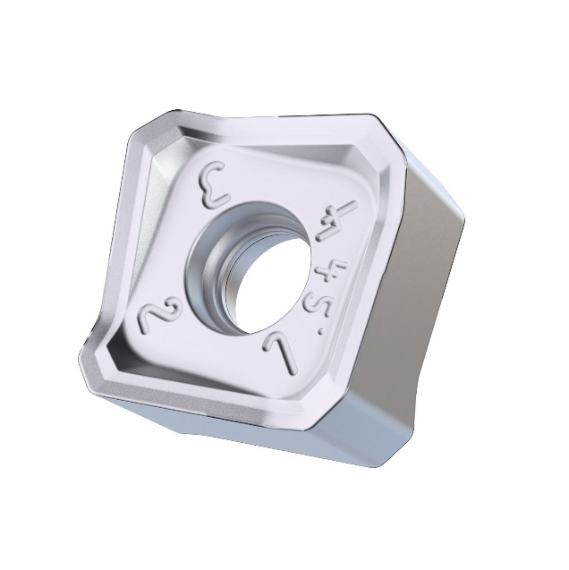
Seco Product Family
SN2024.1 MP3501 Overview
153
Count of GPNs
Seco Discount Groups
Update to existing T350M Product
A09
A13
A15
A16
A17
A18
A19
A20
A21
A24
A29
A82
Full Product Replacement for existing T350M grades
T350M Phase out begins in July
Seco Milling Family Range
Country of Origin
Square Shoulder
Helical Milling
Face Milling
Highfeed
Copy Milling
Disc Milling
Chamfer Milling
Plunge Milling
Sweden

Slide 10
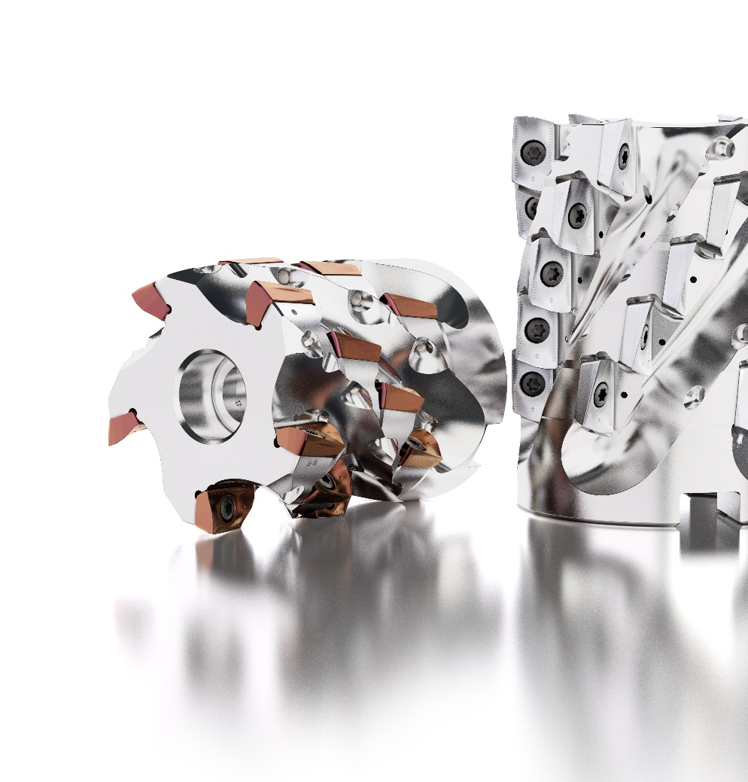
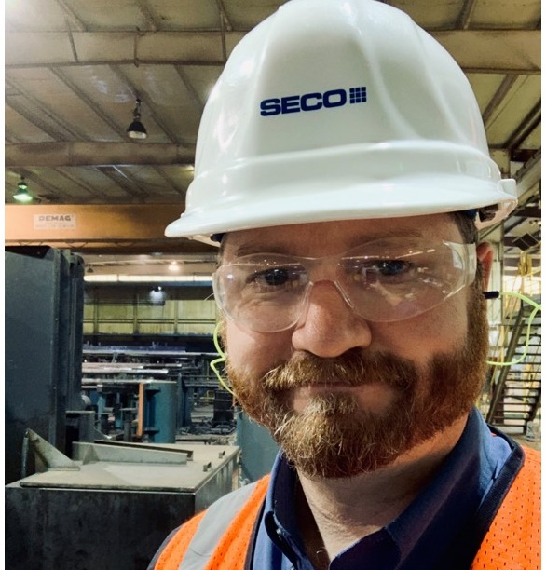
Thank you!
Product Manager Americas
Indexable Milling | Indexable Drilling | Boring Systems | Tooling Systems
Focused on Growth
Jay McCord
Tel. +01 (832) 248-3824
jay.mccord@secotools.com

