Slide 2
BEYOND
THE INSERT
Seco Tools Independent Distributor Product Launch Resources and Programs
Adam Wojciechowski
Distributor Manager (US,Canada)
Adam.Wojciechowski@secotools.com
248.931.9266

Slide 3
Notes:
Psychological safety:
Every employee has the right to feel safe at work to: share ideas, express opinions, ask questions, report problems, receive and give feedback, be listened to, admit mistakes without the fear of being judged, ridiculed, disrespected, punished. Make also sure that you have the agreement of all meeting participants when recording the meeting.
Health & well-being:
Seco refers to the term 'Health & Well-being' when talking about the relationship between our employee's work, life and health. Improving health and well-being through a number of activities and programs that target individual lifestyles is a combined effort of Seco and its employees.
Cyber security:
Cyber security is a key element in keeping our colleagues, customers and company protected. And this involves to be cautious and mindful when clicking on links as an example.

Slide 4

Product Launch 2024.2 Overview
Emails to customers & distributors
Sep 16: launch announcement
Monthly: newsletters that include content of the new and in-focus products.

Slide 5



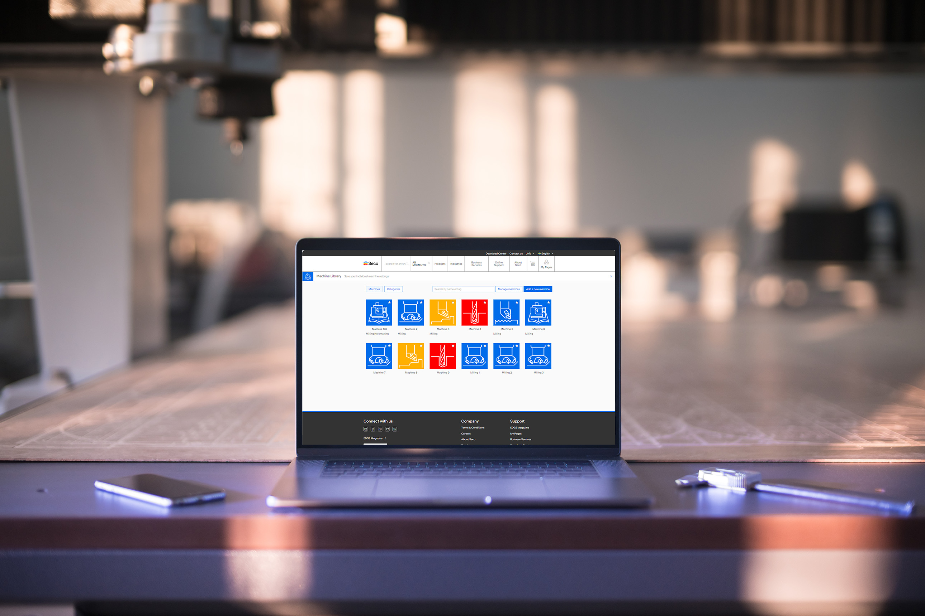

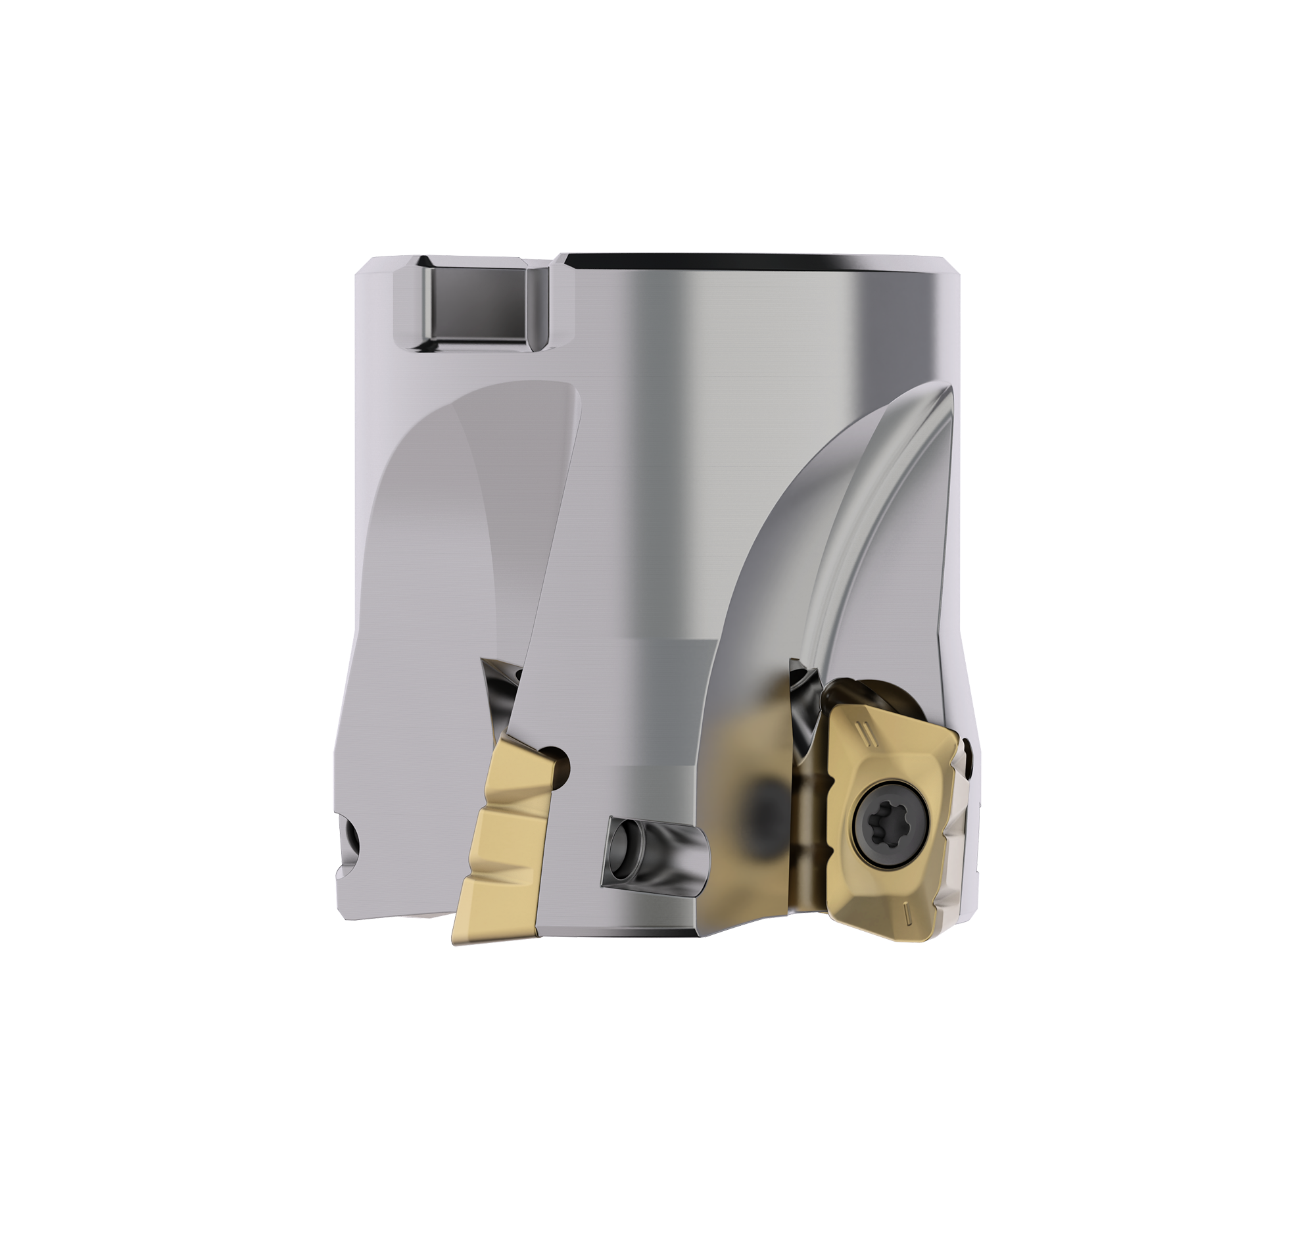
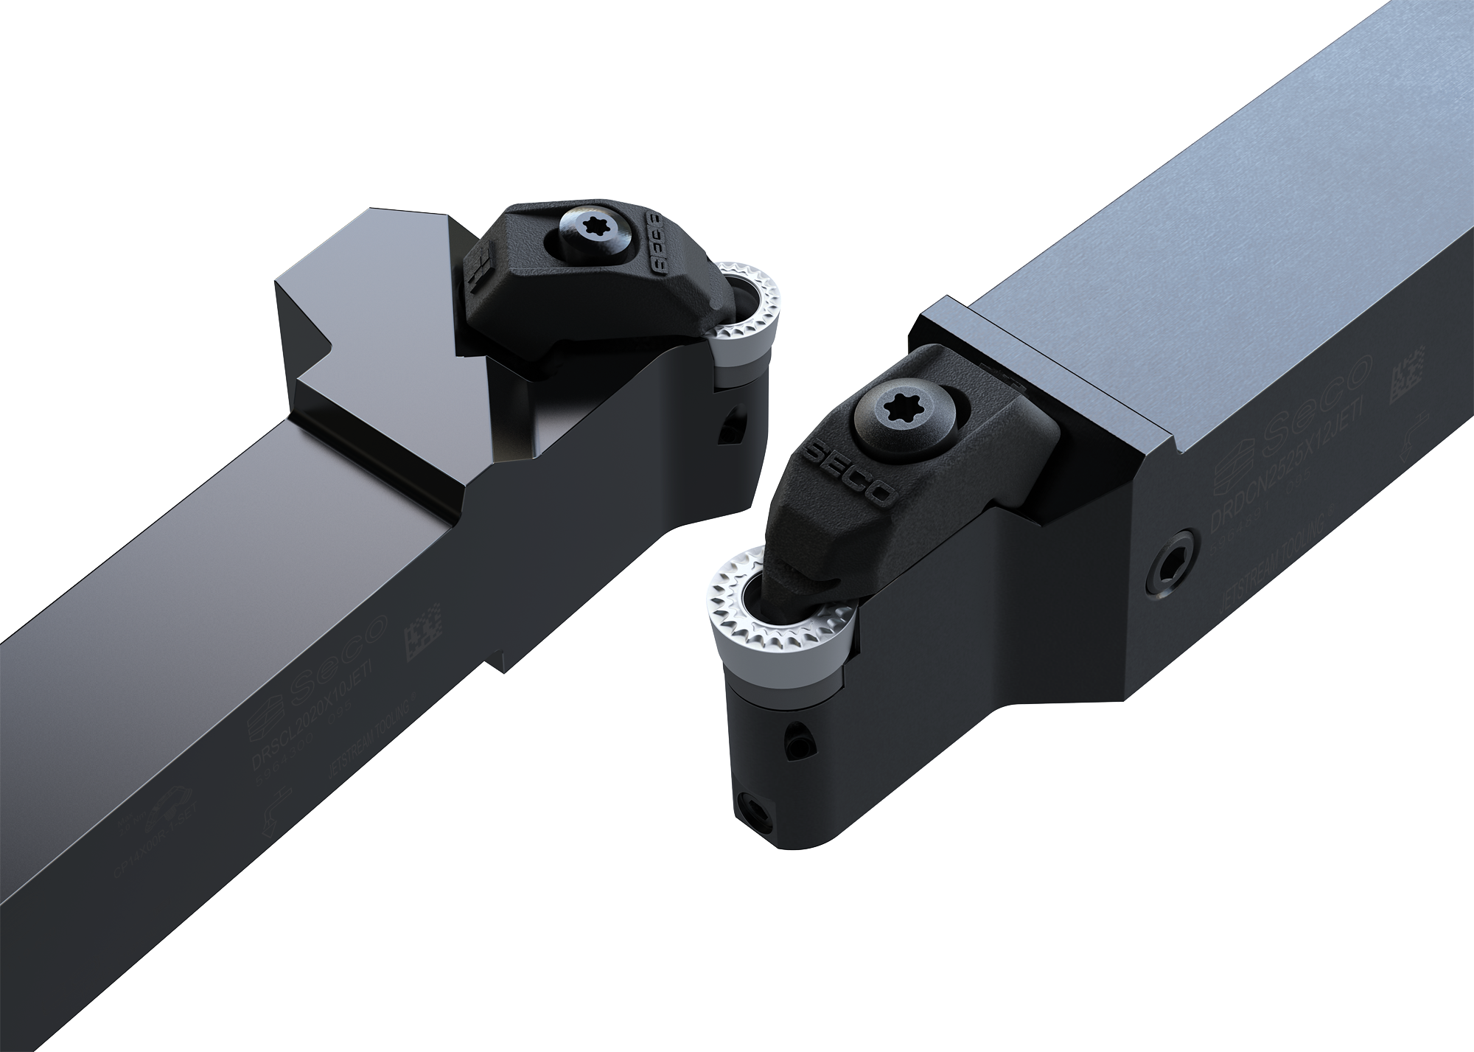

Overview introductions
Launch 2024.2
1497 new reasons to get in front of our customers and prospects
C-Series
S4501/S4651 Additions
T-35H Taps
Machine Library
New Products
C-Series:
LN4-11:
Turbo 12/18 Chip splitter
JETI Toolholders for round inserts
X2 Grooving & Parting-off
S4501/S4651
T35H Taps
Machine Library
LN4-11 Helical
Turbo 12/18 Chip splitter
JETI round inserts
X2 Grooving & Parting-off
Notes:
What is coming for this launch?
New Product line strategy – to mention in this section?
Here is a short overview of the newly launched products. We‘ll go more in-dephts on the following slides.
There will be a session on each new product and service with even more detail, so enroll into Workday if you haven‘t done it yet.

Slide 6

C-Series
Product Manager - JL Ball jl.ball@secotools.com
Product – C-Series
End mills with focus on versatility and economy
Square, ballnose and chamfering geometries
Full metric and inch assortment
High performance SIRON-A coating
Suitable for steel, cast iron and stainless steel
Additional Offer
Data matrix available for key product data
Regrinding offer available (up to 3 times) with original quality and performance
Target market
Distribution channel with focus on General Engineering
Customers with High mix – Low volume production seeking easy to use, reliable and economical solution
Subcontractors with focus on process security and versitility
Selling points
Exceptional reliability
High versatility with focus on low cost per edge
Up to 30% increased tool life over previous generation

Slide 7

S4501/S4651 Aluminum series
Product Manager - JL Ball jl.ball@secotools.com
Product – S4501/S4651
S4501/S4651 series offer a full solution in aluminium machining
S4521-S4531 high performance square endmill for general machining
S4321 2- flute high accuracy ballnose for copy milling applications
S4651 is a 5 flute end mill with chip splitters, for roughing and dynamic milling machining
AXT-Coating
Comprehensive range to compete better
Additional Offer
Data matrix available for key product data
Regrinding offer available (up to 3 times) with original quality and performance
Target market:
  Sold direct and through industrial distribution.
  Focus on Aerospace, Medical, General Engineering
Benefits advanced coating technology:
The polished AXT coating has a very smooth coating surface, significantly reducing material built up edge, thereby improving workpiece surface finish and reducing cutting forces
Benefits of chip-splitters:
Staggered chip splitters increase chip control (better chip removal in fe. deep pockets) and reduce cutting forces allowing high APMX values in one pass
Notes:
FR
Questions:
What is the target application? (finishing, roughing?)
Target market?
What benefits do the advanced coating technology give?
Benefits of chip-splitters should be explained…

Slide 8
Taps T35-H
Product Manager – Abhay Chaubal abhay.chaubal@secotools.com
Product – Taps T35H
Suitable for heat treated steel with hardness
30-45 HRC (Rm = 1000-1400 MPa), cast iron and cast aluminum
Highly wear resistant taps in heavy conditions when machining abrasive materials.
Target market
Automotive: Cast parts, pump and gear housing, transmission components
General engineering: Heat treated components, shafts, gears, components of agricultural and construction equipment
Mold & Dies
Selling points
Longer tool life
Better chip evacuation
High strength and rigidity of the tool
Better surface quality
Lower energy consumption
Notes:
FR
Questions:
-What is heavy?
-What hardness are they focus on?
-Target market?
Handover to Gerrit

Slide 9

LN4-11 Helical
Product Manager – Jay McCord jay.mccord@secotools.com
Product – LN4-11 Helical
We are now offering a new high performance and economical helical milling cutter with a reliable design in the smaller diameter area. It’s positioned for smaller diameters than SN8-13 and with more cutting edges than the Helical Turbo 12.
Target Market
main usage in the aerospace segment but also general engineering and automotive.
For all workpiece materials
Selling points
Low cost per setup compared to other solutions with 4 edges per insert
First row using Turbo 12 inserts enabling a wide rage of radii and geometries.
No compromises in productivity
High versatility in applications (Radii, Ae, Ap, materials)
User friendly and reliable to limit downtime
Connected tool providing access to Seco experience through DM scanning
Sustainable product thanks to a more responsible choice of production processes and materials
Notes:
FN

Slide 10

Turbo 12/18 Chip splitter
Product Manager – Jay McCord jay.mccord@secotools.com
Product – Turbo 12/18 Chip splitter
Chip splitter insert additions to the Turbo 12 and Turbo 18 range.
Suitable for long tool overhang and unmanned machining for increased process reliability
Problem solver where standard inserts doesn’t work
Vibrations
Large chips (split in 3)
Selling points
Improved Chip Control
Reduced power consumption
Enhanced process stability
Target Market
All applications with large depths of cut
Most kind of workpiece materials.
Notes:
FN
Selling points:
Improved Chip Control: The chip splitter inserts cut chips into smaller pieces, preventing jamming and improving evacuation.
Reduced Power Consumption: Smaller chips require less energy, lowering power consumption.
Enhanced Process Stability: Improved chip control enhances stability, making it ideal for unmanned and long tool overhang machining.

Slide 11
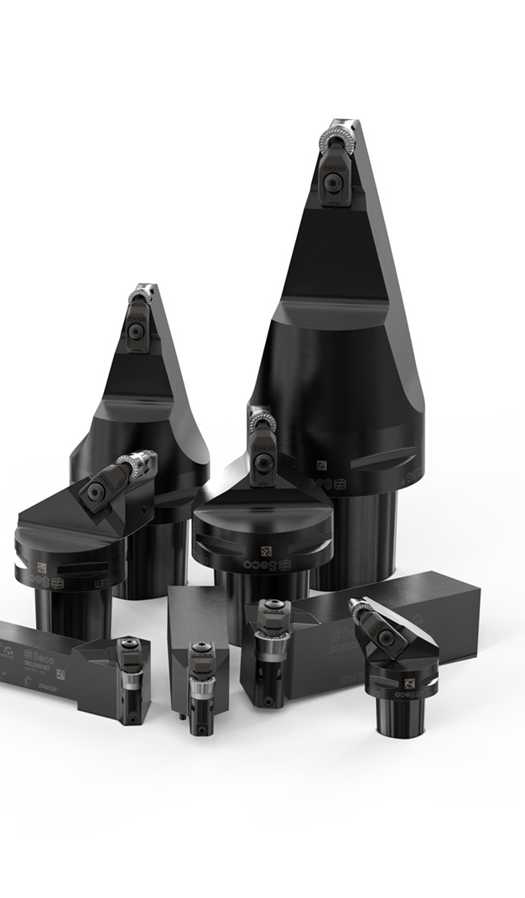
JETI Toolholders for round inserts
Product Manager – Abhay Chaubal abhay.chaubal@secotools.com
Product – JETI for round inserts
Addition to Jetstream Tooling® (JETI)
Square shank
Seco-Capto
Seco-Capto MTM
Target Market
Aerospace and other customers with difficult chip breaking
For most workpiece materials especially tough
ISO S and ISO M.
MTM machines doing complex components
Selling points
Suitable for dynamic turning with round inserts MF2 chip breaker.
Increased tool life and improve part quality
Hose less solution also for square shanks
3D printed coolant clamp
Notes:
FN

Slide 12
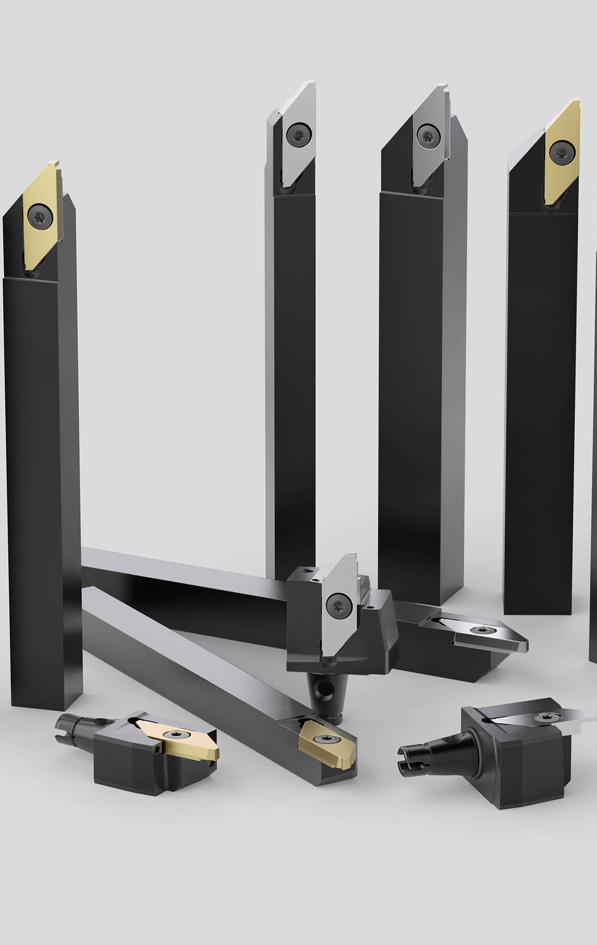
X2 Grooving and parting-off
Product Manager – Abhay Chaubal abhay.chaubal@secotools.com
Product – X2
For swiss type machines, mainly for ISO P and M and titanium materials
With and without Quick-Change connections
Inserts with 2 cutting edges
Primarily for work piece diameters 1-16 mm
Max parting off diameter 16 mm,
Grooving & profiling inserts goes to 8 mm deep
Selling points
Flexibility and Versatility with many inserts
Quick-Change Solution with high repeatability
+/- 0,003 mm / ≤0,001 inch
Good insert repeatability of +/- 0,025 mm / 0,001 inch
Easy and quick handling
Reduce interruptions and machine down time
1 Toolholder for all insert types
Target market
Swiss Machining, Small Parts
Components could be for many segment, typical subcontracted. Companies specialized in small parts machining
Notes:
FN

Slide 13
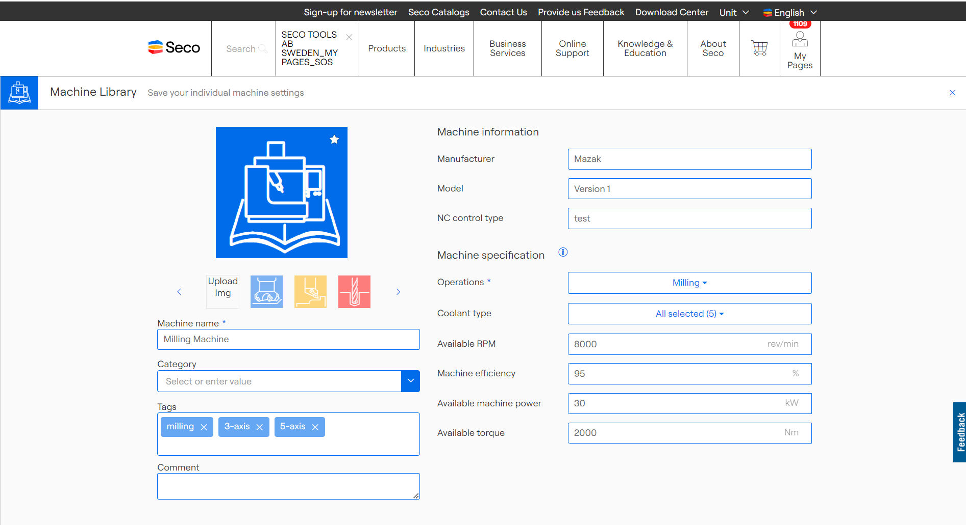
Machine Library
Easily manage and configure all your machines, fully integrated with Seco My Pages
Simplified Workflow: Makes machine management easy and productive.
Time Efficiency: Minimizing time spend on searching for the right tools
Reliable Outcomes: Provide consistent and reliable cutting data based on specific machine settings.
Available through My Pages
Internal Users – Released since June 2024
Customers, Distributors – Release will be on 09th of September at 09:00
Notes:
Simplified Workflow: The Machine Library portlet offers an intuitive interface within My Pages, streamlining machine management and integration to enhance customer productivity.
Time Efficiency: Customers can swiftly find tools by combining their machine-settings with existing MyPages functionality, minimizing time spent and reducing machine downtime.
Reliable Outcomes: Having the Machine-settings integrated helps allows customers to easily manage and verify cutting data, ensuring consistent and reliable machining results

Slide 14

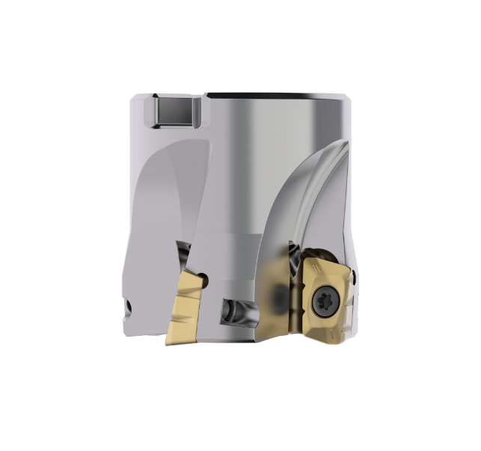
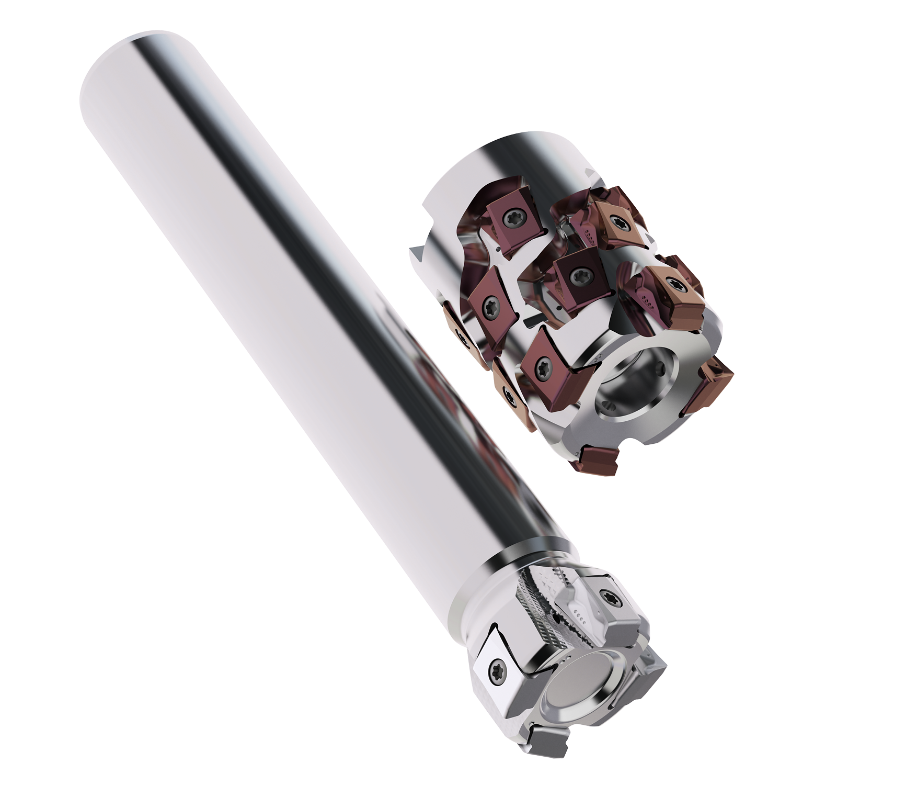

Marketing material (Internal)
Launch 2024.2
C-Series
LN4-11 Helical
Turbo 12/18 Chip splitter
JETI for round inserts
Material available on Global Sharepoint and Media Platform
Content kits
Press releases
Images
Factsheets
PPT internal and external
Email signatures and banners
Launch 2024.2 summary ppt (short introduction of the products included in the launch)
Videos
  Turbo Chip splitter - application video and animation
  LN4-11 application video
  T35-H – application video
  JETI for round inserts - animation
  Machine library – video (soon to be finalized)
  C-series, internal animation
  X2 animation (soon to be finalized)
  S4501/S4651 application (soon to be finalized)
Web and social media
  Updated content and landing pages on secotools.com
  Carousels and videos for our social media channels
X2 Grooving & Parting off
S4501/S4651 Additions
Taps T35H
Machine Library

Slide 15
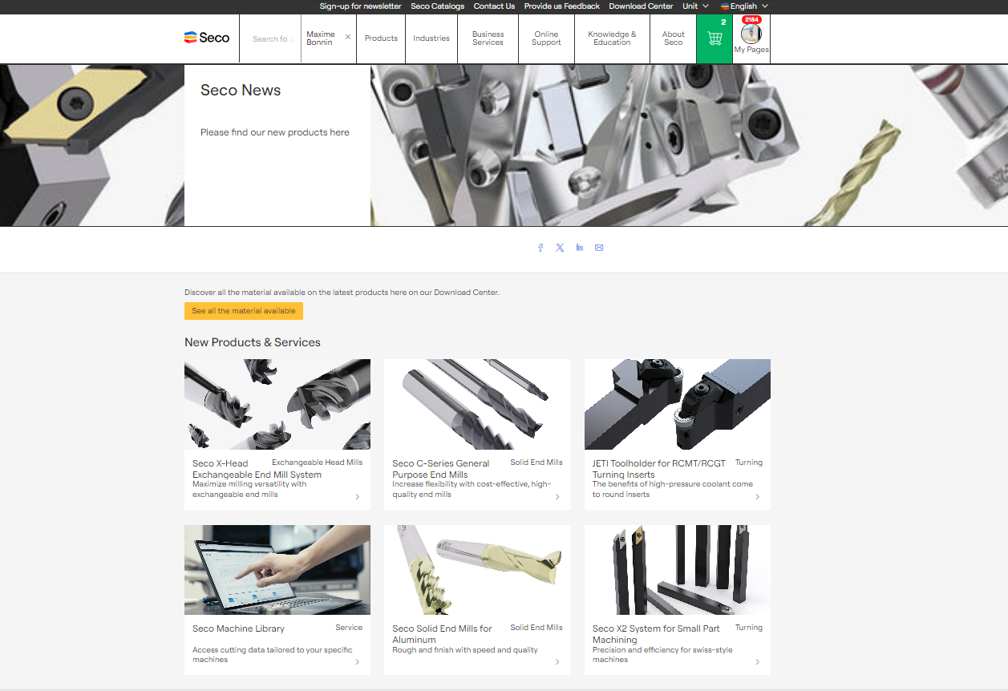
WHAT TO FIND WHERE ON THE WEBSITE https://www.secotools.com
The Website
Seco News page (gather all new products)
One campaign page per new solution
Factsheet
New catalogs
Button to discover the range in the product tree
Embedded pictures and video to describe the product
Factsheet connected to each campaign pages
Related content around the same topic (news, articles, white paper, ...)
Notes:
MaxB – 2 min

Slide 16
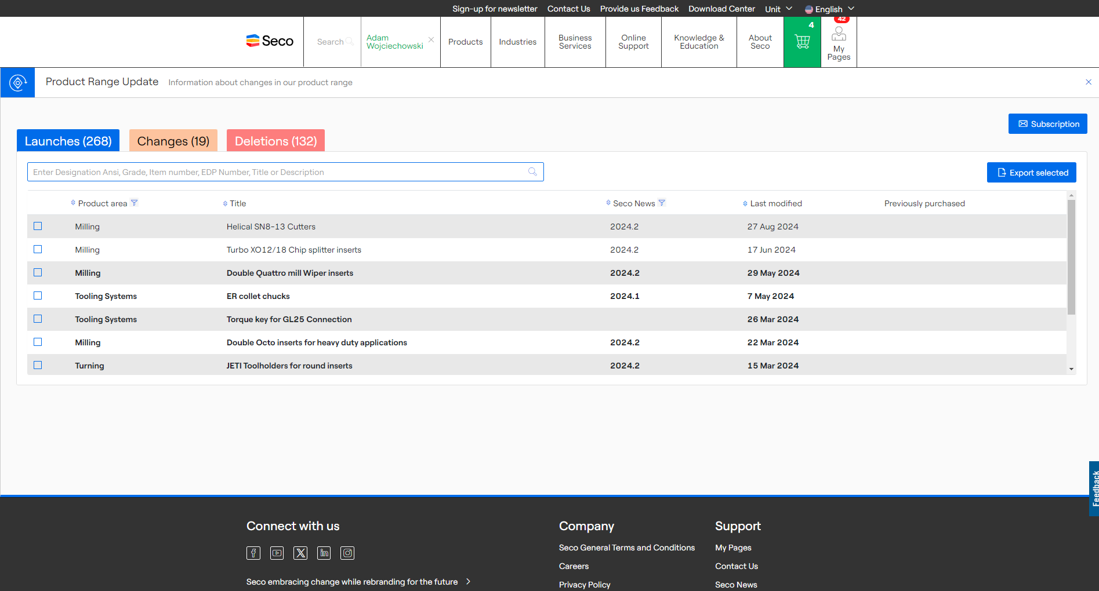
Seco Tool Product Range Portal https://www.secotools.com/dashboard/Portal

Slide 17
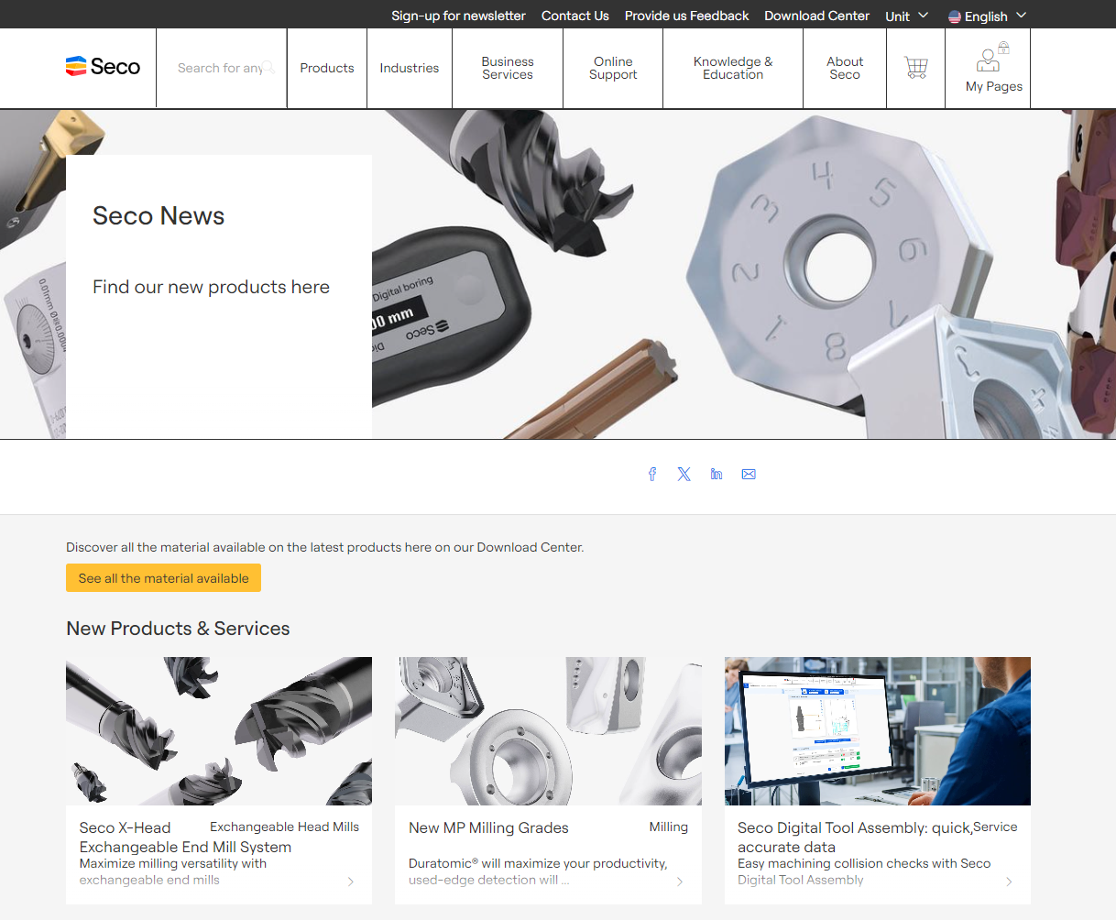
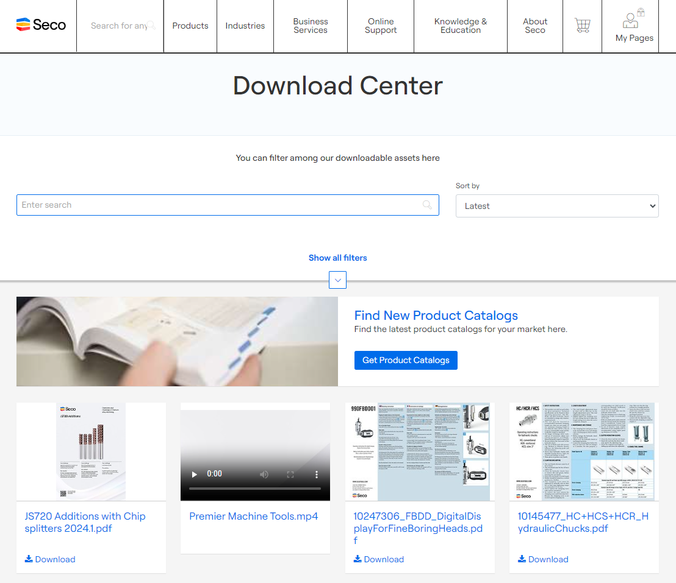
Seco News and Download Center – Latest from Seco Tools, New Products and Digital Catalogs, Literature and White Papers and Guides. https://www.secotools.com

Slide 18
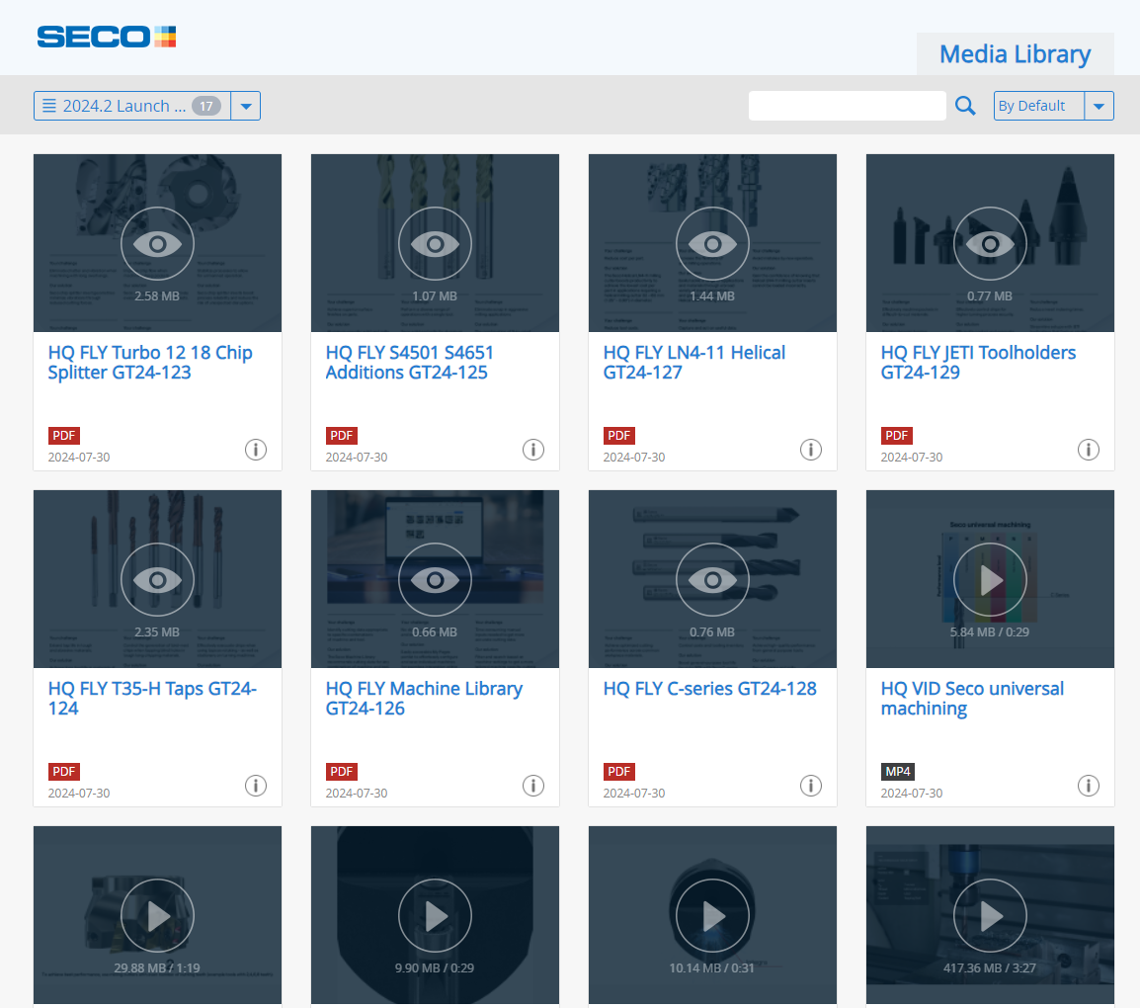
SECO TOOLS Showcase
Digital literature
Animations videos
Application videos

Slide 19
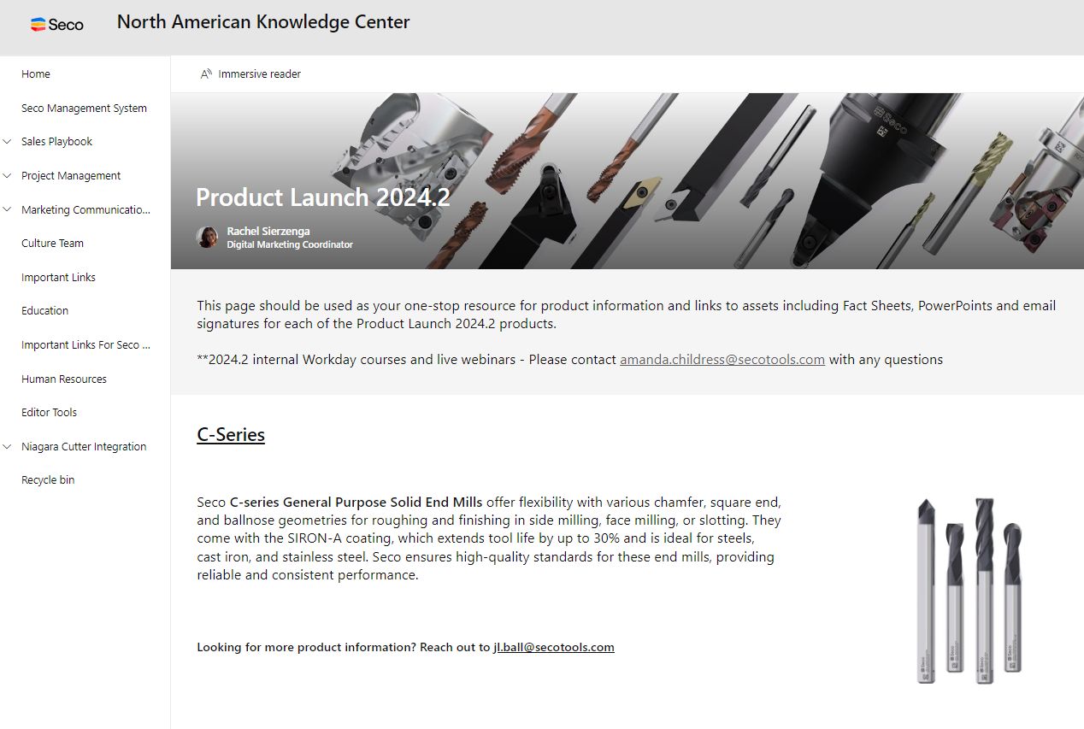
Marketing Knowledge Center Page
Product descriptions
PPTs
E-mail signatures
Landing Pages
Digital + printed literature

Slide 20

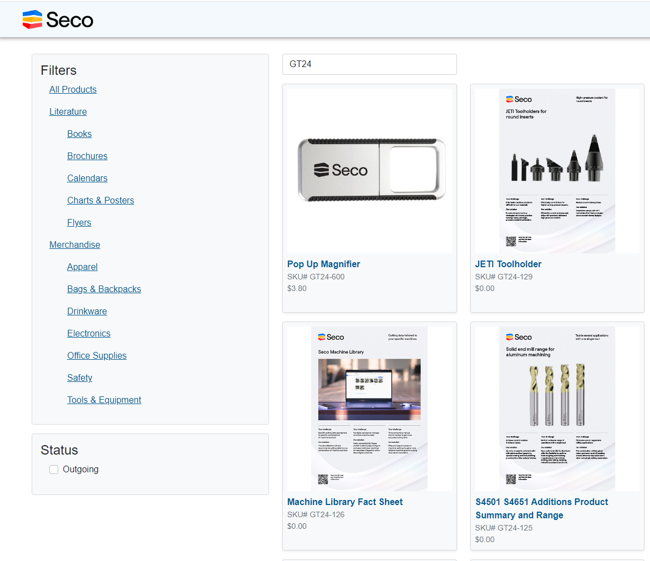

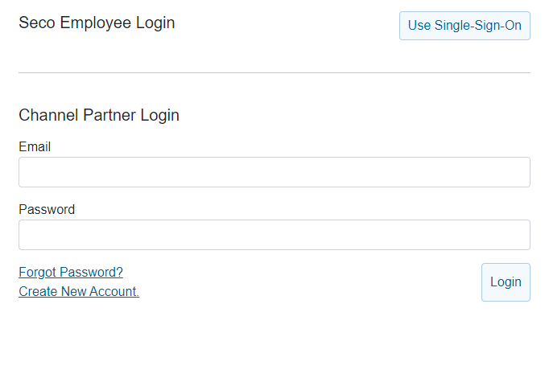
SECO MARKETING STORE https://store.secomarketing.com/login

Slide 21






What‘s available to order for the Product Launch? https://store.secomarketing.com/login

Slide 22
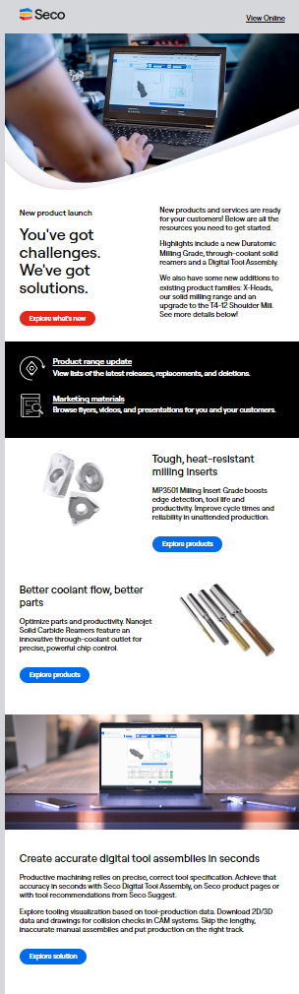
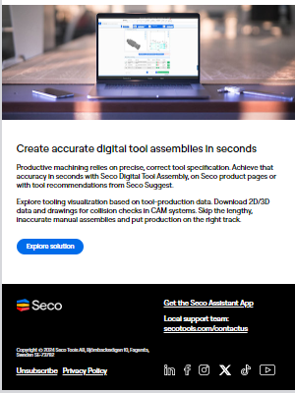
Seco Tools Channel Communications – E-Mail, Newsletter (Starting Sept. 16th)

Slide 23
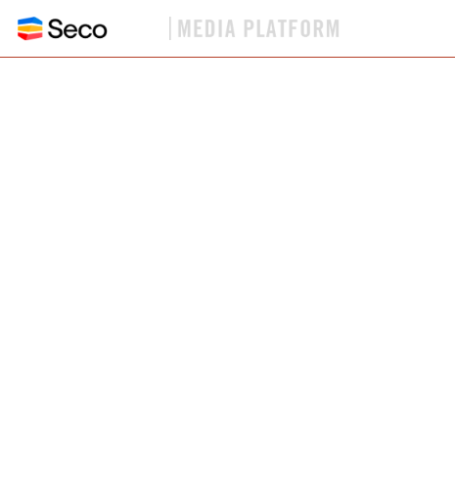
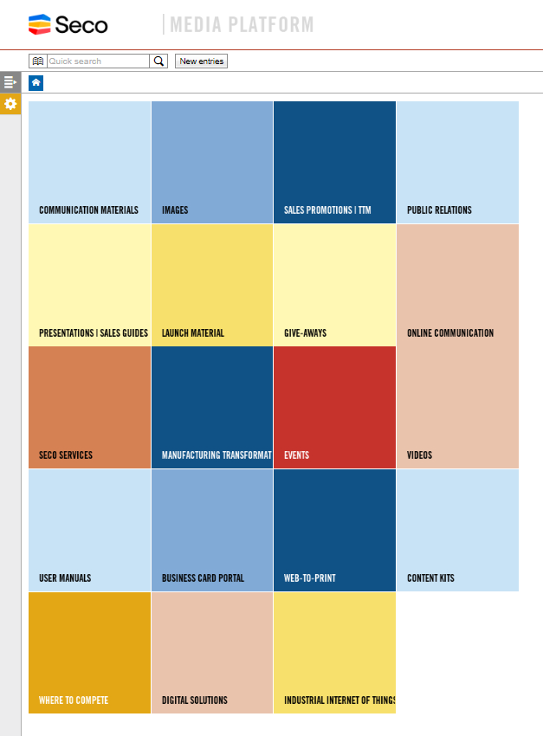
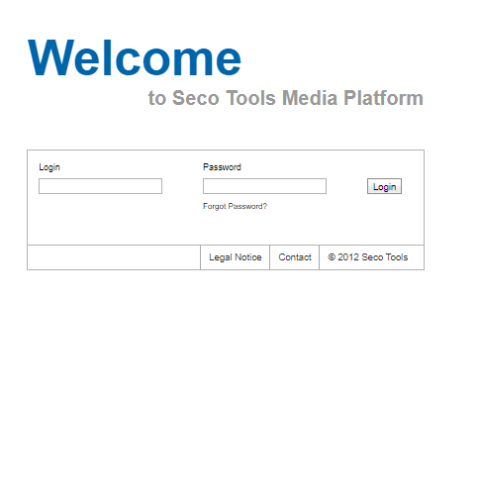
SECO TOOLS MEDIA PLATFORM
https://mediaplatform.secotools.com/

Slide 24

Co-op Funding
Goldstar
GoldStar Distributors have access to co-op funding equivalent of up to 1% of their annual purchases. ($10,000 maximum)
1
Seco related training fees and associated hotel/travel expenses.
2
A maximum 25% of the total co-op fund allotment will be designated for the reimbursement of co- branded wearable material (i.e. shirts, hats, jackets etc.).
3
Seco will reimburse digital marketing flyers and web advertising materials (banners or videos on website etc...) at 100% under its co-op program
4
50% reimbursement for the following expenses –
Seco Specific Promotional Materials and Programs
Co-Branded Printed Literature (Seco printed literature)
Seco Specific Incentives for Distributor Sales Personnel (spiffs)
Pro-Rated Trade Show Floor Space Cost and Signage

Slide 25





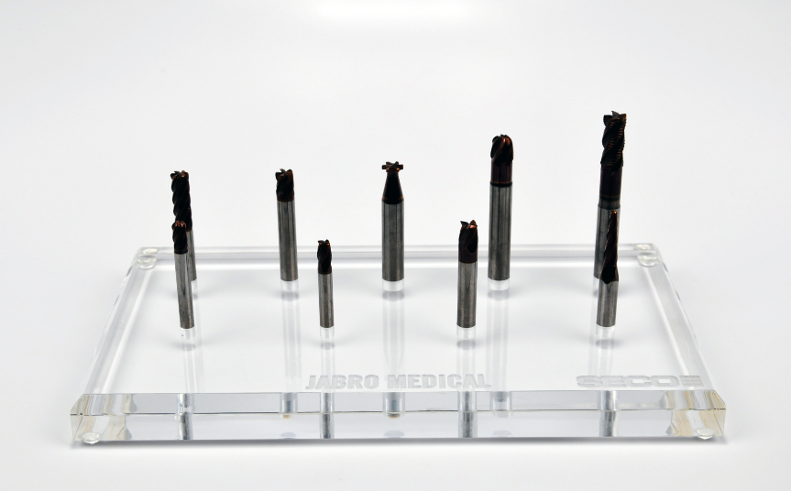


Slide 26

Test Tool Program
GoldStar Channel Partners
1
Seco will assign a test budget at the beginning of the year. (0.8% of previous years total purchases)
2
Test orders ship free of charge
3
Report test results to SECO within 90 days.
4
Only succesful tests will be invoiced. Budget adjusted based on test result.
5
Reminders sent automatically via email if an order is not reported.

Slide 27
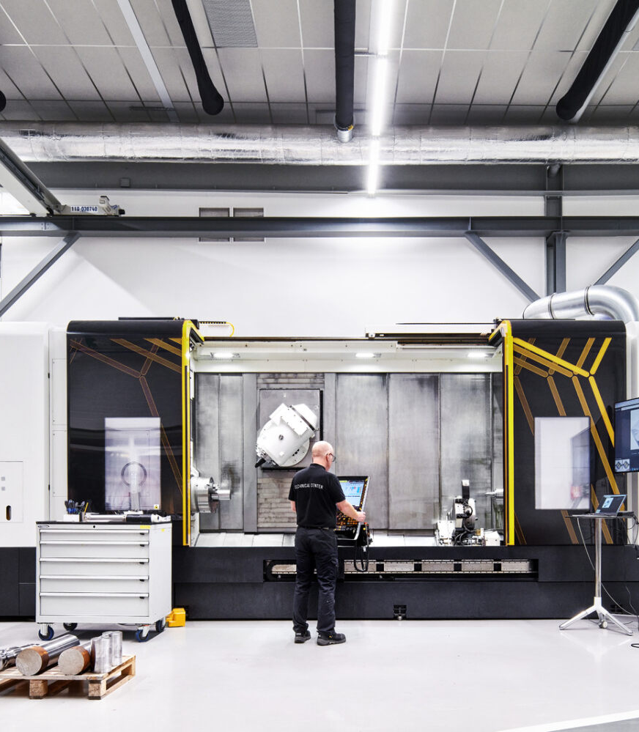
Tooling Voucher Program
TOOL UP YOUR NEW MACHINE AT UP TO 50% OFF*
1
Benefit from deep discounts across a wide variety of standard products!
2
A great way to secure repeat insert sales!
3
Great opportunity for conversions!
Your distributor representative will work with Seco to establish a tooling voucher based on the price of your new or used machine. (The voucher value will be 10% of the machine invoice value and considered Seco Net Pricing.)
You’ll receive a voucher with the assigned value and a unique serial number.
Have your distributor representative submit your order to Seco Customer Support (customerservice@secotools.com for US and Canada & soportemx@secotools.com for Mexico), referencing the voucher serial number to receive up to 50% off on all standard steel products.

Slide 28

Seco Recycling program
What we offer – Business services
1
Easy to use – recycle and get paid!
2
Seco provides free recycling bins, covers transportation fees, and will issue a check based on weight
3
Check amount is based on the price per pound of used carbide at the time of RMA creation
Seco will recycle any of your used carbide products, including solids and anvils. Upon receipt, the used carbide will be sorted and weighed, and you will be compensated.
The following carbide products are suitable for recycling: inserts, solid drills, solid end mills, PCD/PCBN (tipped inserts only) and wear parts.

Slide 29
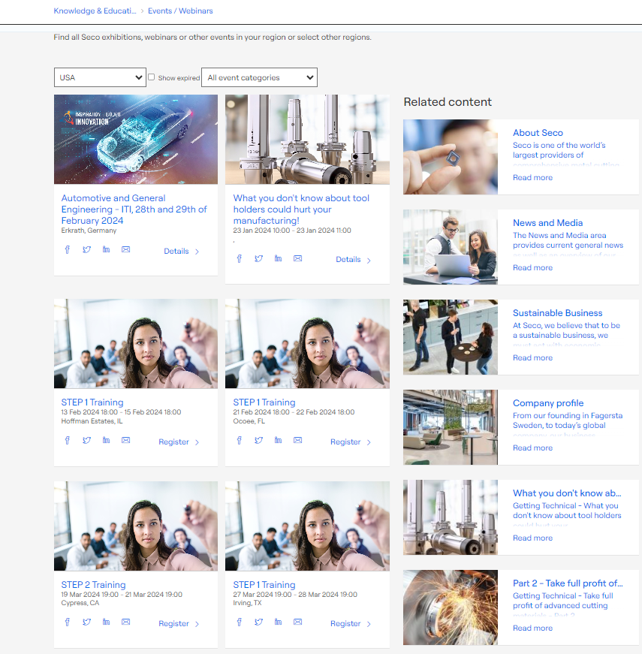
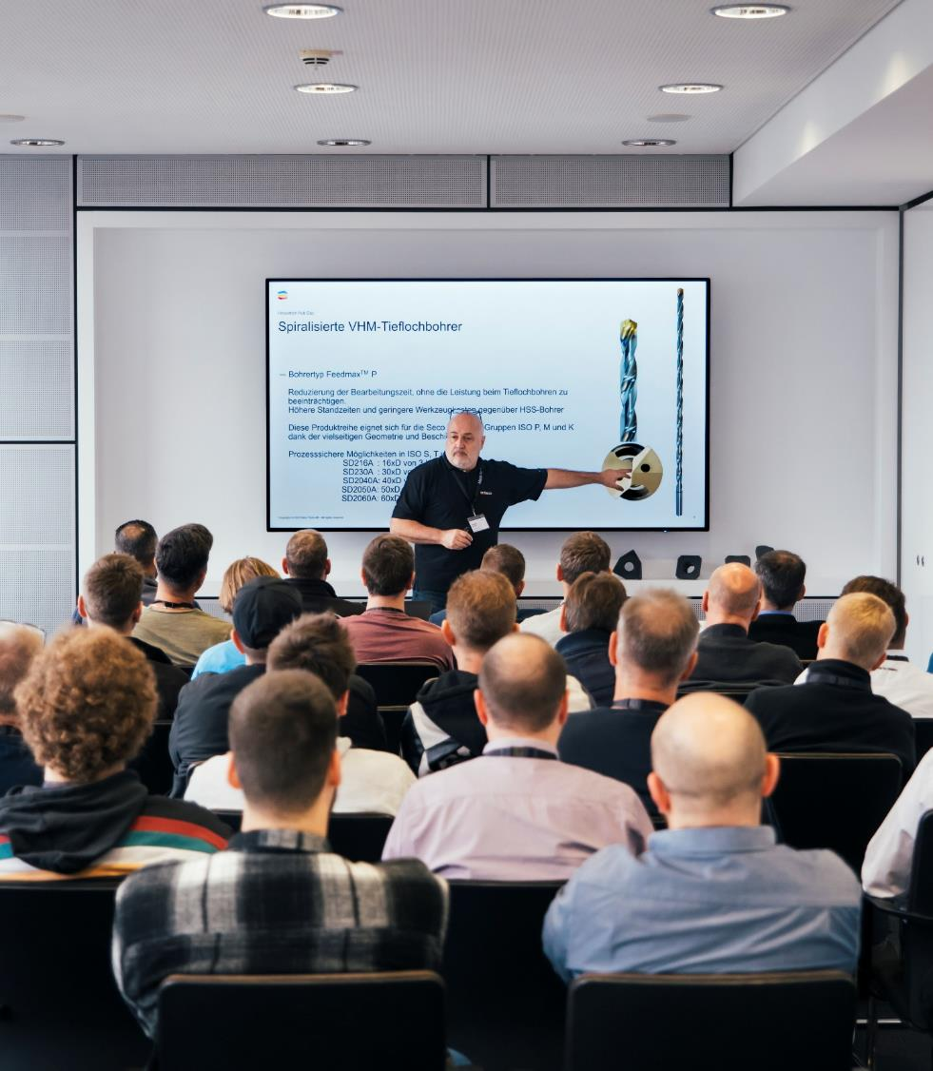
Seco STEP education
What we offer – Business services
Improve and maintain competencies at all levels in the machining industry.
Seco Technical Education Program (STEP) modules provide machining fundamentals and advanced application knowledge for everyone in production.
Certified Pro3 Product Specialists - Seco acknowledges Distributor sales personnel who have successfully completed the entire STEP sequence by recognizing them as SP3 Product Specialists – Requirement for Goldstar Distributors
Link -
EVENTS and WEBINAR links and schedule for upcoming STEP Technical trainings - https://www.secotools.com/article/68104
Notes:
Classes are arranged locally mostly in local language.
Available formats may differ, but include
eLearning 24/7 (self-paced, on demand)
instructor led training (physical classroom, face-to-face)
virtual instructor led training (remote, virtual classroom)
blended learning.

Slide 30

Seco Assistant
What we offer - Digital product services
A practical all-in-one mobile solution.
Quick and easy access to product information and online cutting data.
Scan packaging and products.
Calculate cutting data and start values.
Compare Seco products with competitor tools.
Tool-wear optimizer support in troubleshooting.
Offline applicable.

Slide 31

Inventory management
What we offer – Business services
Control, track and manage shop floor consumption and inventory levels worldwide 24/7.
Manage inventories through user-friendly, secure tooling storage point-of-use solutions.
Optimize inventory levels and prevent excess waste with automatic inventory replenishment and reporting.

Slide 32

Additional Technical Training Resources
What we offer – Business services
STEP Training Events/ Dates /Registration - https://www.secotools.com/article/68104
Online pdf Catalogues for SECO Products - https://www.secotools.com/article/84565
SECO Assistant tools. Tool Optimization, Machining Calculators, Compare products, Material Categories - https://www.secotools.com/article/114039
SECO Suggest, an online tool to provide you with instant, expert machining advice that is best suited for your applications. - https://www.secotools.com/article/118862
Technical Training, videos series - https://www.secotools.com/article/122032
Technical Guides, materials, tool references - https://www.secotools.com/article/120053
LinkedIn training events and webinars. Hosted by SECO - https://www.linkedin.com/company/seco-tools/events/ -
Seco Online Academy - https://step.manufacturingtransformation.io/courses
Notes:
Classes are arranged locally mostly in local language.
Available formats may differ, but include
eLearning 24/7 (self-paced, on demand)
instructor led training (physical classroom, face-to-face)
virtual instructor led training (remote, virtual classroom)
blended learning.

Slide 33
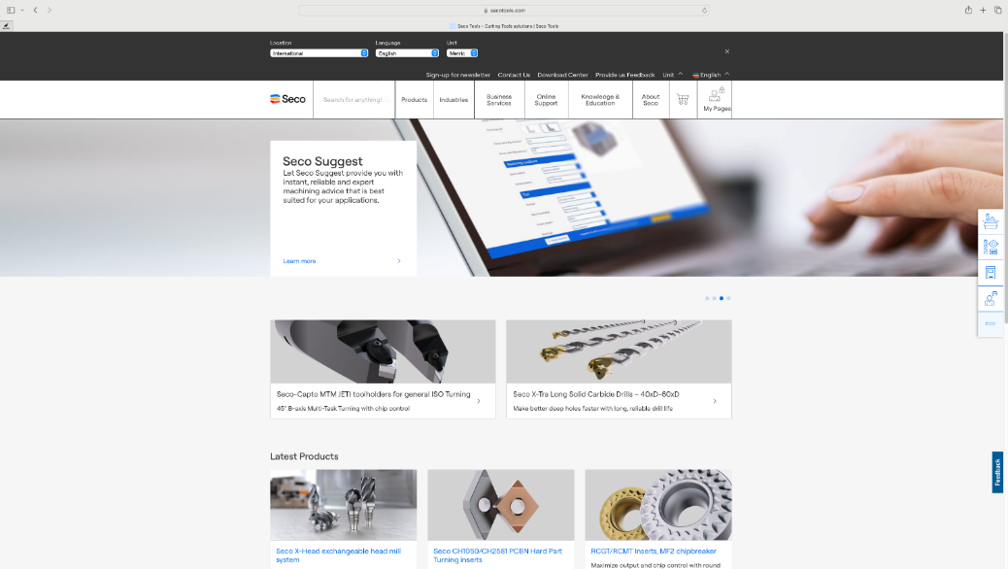
One site.
Everything in one place.
secotools.com
Notes:
Simplification and enhancement of the secotools.com experience to provide the resources you need to improve productivity
in one centralized location.

Slide 34
Thank you

