Slide 1

MY PAGES Product Search PORTLET

Slide 2
YOUR SAFETY IS
OUR TOP PRIORITY
EMERGENCY EXIT
ALARM
ASSEMBLY POINT
EMERGENCY NUMBER
PROTECTIVE EQUIPMENT
PSYCHOLOGICAL SAFETY*
*Psychological Safety means to include everybody in the meeting (including yourself),
sharing knowledge, listen to other people and confirming their contribution.

Slide 3

AGENDA
Access the portlet
SEARCH PRODUCTS
Get support

Slide 4

1
ACCESS the portlet

Slide 5
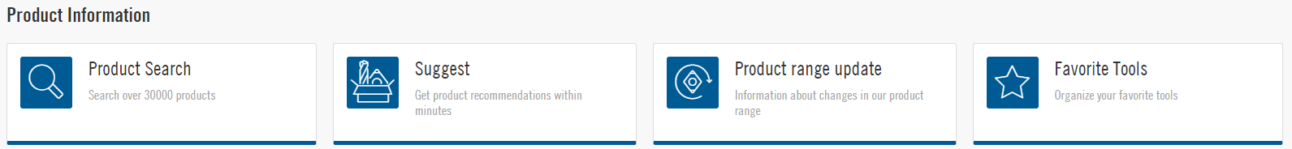
USE YOUR MY PAGES ACCOUNT
Go to secotools.com and click on My Pages
After signing into your account, you will see all the different portlets you have access to, including the “Product Search” portlet

Slide 6

2
SEARCH
PRODUCTS

Slide 7
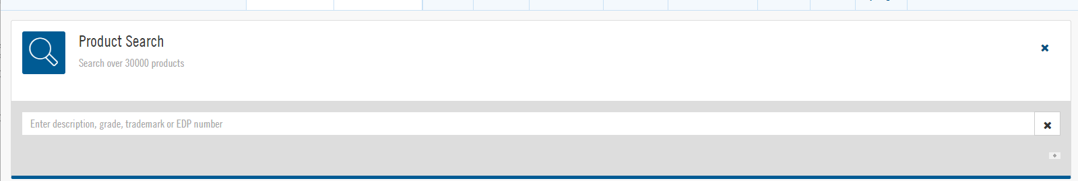
How to search products in product search
Click on the Product Search icon to prompt the search bar where you will be able to search for a product with the Seco 5-digit number, Seco 8-digit number, AINSI description, or ISO description.

Slide 8
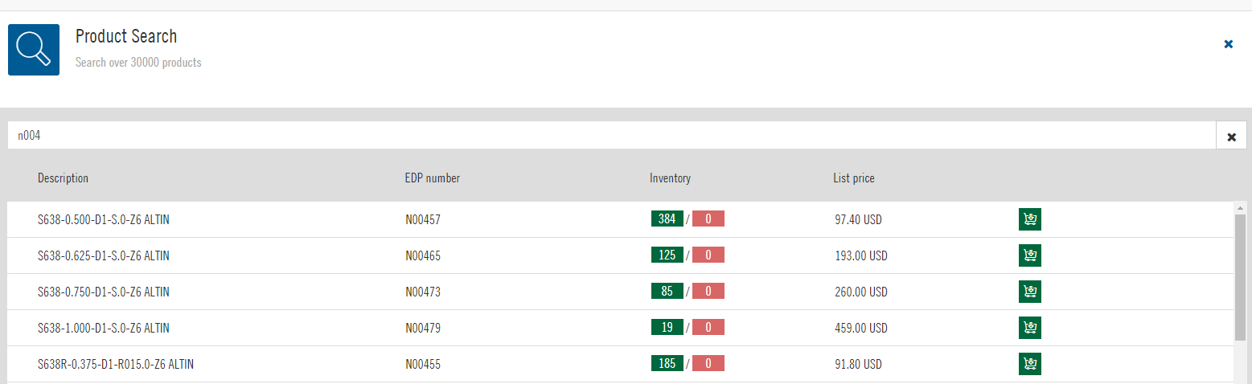
How to search products in product search
As you type in a designation, the app will begin to populate potential matches where you will see pricing and stock availability. When you are logged in, you will see net pricing.

Slide 9

3
Get support

Slide 10

SECO CUSTOMER SUPPORT
Our customer support team can answer your questions regarding our Product Search Portlet
You can reach our customer support team at:
  customerservice@secotools.com
  1-800-832-8326, #1

Slide 11

Thank you!

