Slide 1

MY PAGES ORDER TRACKING PORTLET

Slide 2
YOUR SAFETY IS
OUR TOP PRIORITY
EMERGENCY EXIT
ALARM
ASSEMBLY POINT
EMERGENCY NUMBER
PROTECTIVE EQUIPMENT
PSYCHOLOGICAL SAFETY*
*Psychological Safety means to include everybody in the meeting (including yourself),
sharing knowledge, listen to other people and confirming their contribution.

Slide 3

AGENDA
Access ORDER TRACKING
LOOK UP ORDERS
ORDER SUMMARY VIEW
ORDER DETAIL VIEW
Get support

Slide 4

1
ACCESS the portlet

Slide 5
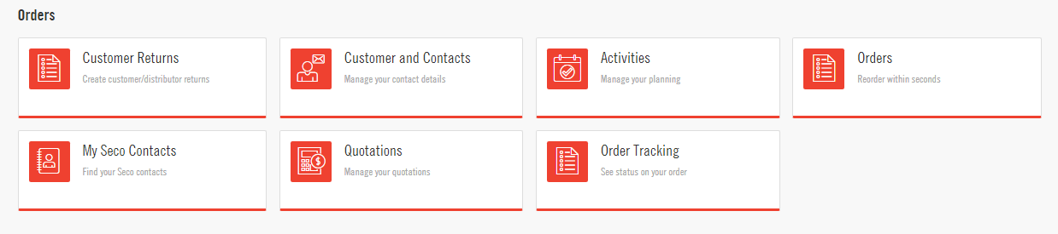
USE YOUR MY PAGES ACCOUNT
Go to secotools.com and click on My Pages
After signing into your account, you will see all the different portlets you have access to, including the “Order Tracking” portlet

Slide 6

2
LOOK UP ORDERS

Slide 7
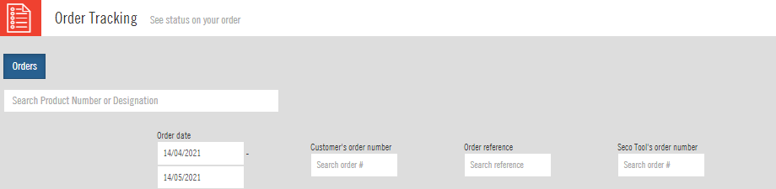
HOW TO LOOK UP AN ORDER IN ORDER TRACKING
Look up an order by date (default setting)
  When you first open the Order Tracking portlet, a date range of the prior 30 days will be automatically displayed as shown below.
  You can select any other date by clicking in the date search box – this will bring up a calendar
  Note: dates are displayed in a European format, DAY/MONTH/YEAR. In the below example, the date range is April 14th to May 14th, 2021
Option 1= Search by date

Slide 8
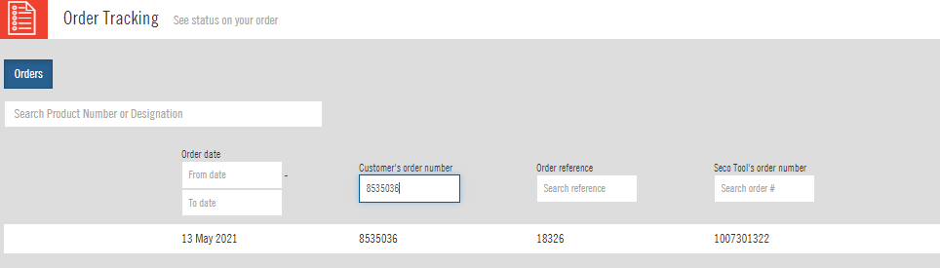
HOW TO LOOK UP AN ORDER IN ORDER TRACKING
2. Search by your PO Number
  You can look up any order by typing in your PO number in the “Customer’s Order Number” search box
  Note: make sure to remove any data in the date range prior to typing in your PO number
Option 2= Search by PO #

Slide 9
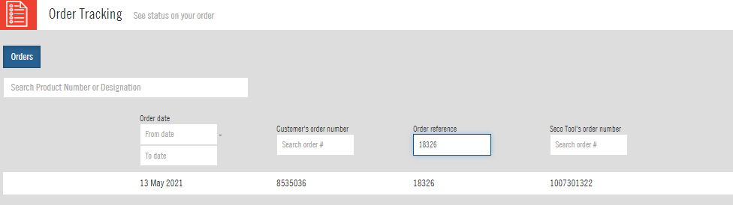
HOW TO LOOK UP AN ORDER IN ORDER TRACKING
3. Search by your customer PO number
  When you reference your customer PO number at order entry, this value will be captured in the “Order Reference” field in our ERP system
  You can search a specific order by typing the reference number in that field as shown below
  Note: make sure to remove all data from the other search fields
Option 3= Search by your customer PO number

Slide 10
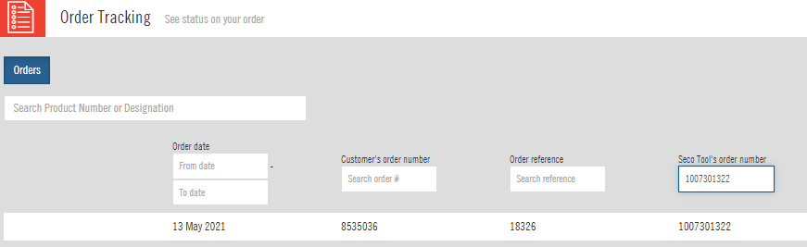
HOW TO LOOK UP AN ORDER IN ORDER TRACKING
4. Search by Seco’s order number
  Seco’s order number assigned to any of your specific orders is provided on documents like the order confirmation or the invoice
  You can search an order by typing in Seco’s order number in that field as shown below. You will most likely not use that option often
Option 4= Search by Seco’s order #

Slide 11
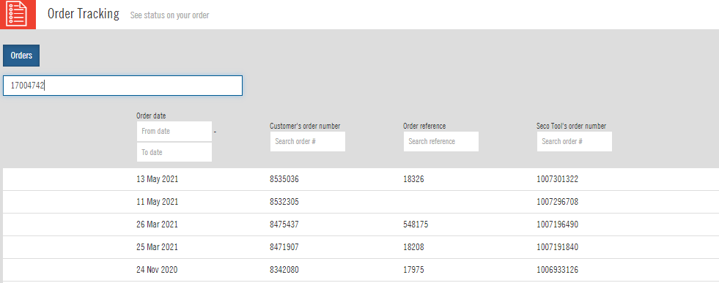
HOW TO LOOK UP AN ORDER IN ORDER TRACKING
5. Search by Product Number or Description
  You can enter Seco’s product number or description in the top search field
  The system will then display a list of all the orders you placed for that specific product, from the most recent to the oldest one
Option 5= Search by product number or description

Slide 12

3
ORDER SUMMARY VIEW

Slide 13
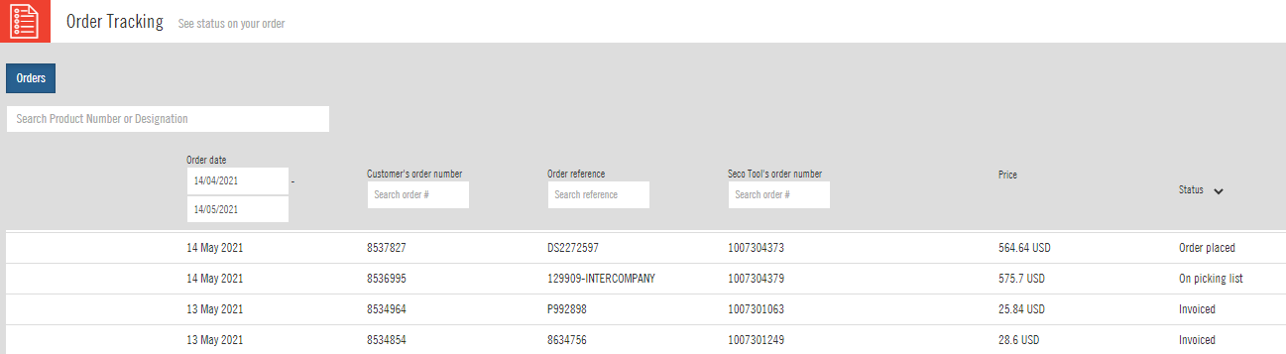
ORDER STATUS AND PRICE
Regardless of the search option that was used, search results will first display a summary view showing the order status and price
The status reflects the lowest status for the full order. An order will still show as “Order placed” even if some items already shipped, as long as there is still a back order on it
Only the detail view will show you the status of each item on the order
The price reflected in the summary view is also the total price for the order

Slide 14

4
ORDER DETAIL VIEW

Slide 15
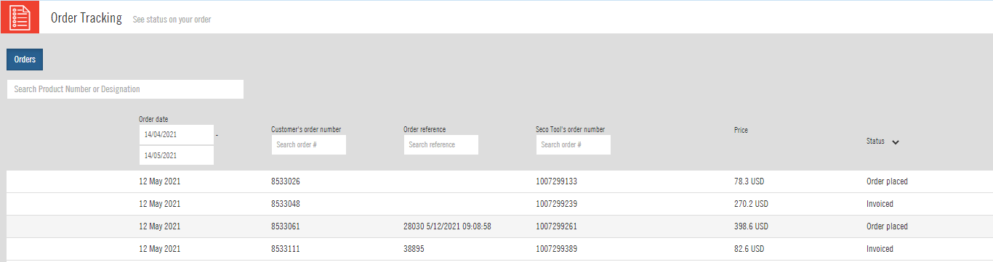
Access the DETAIL VIEW
To view the status of every item on the order, access tracking number or view item level pricing, you need to access the detail view.
To do so, click on the order line in the summary view

Slide 16
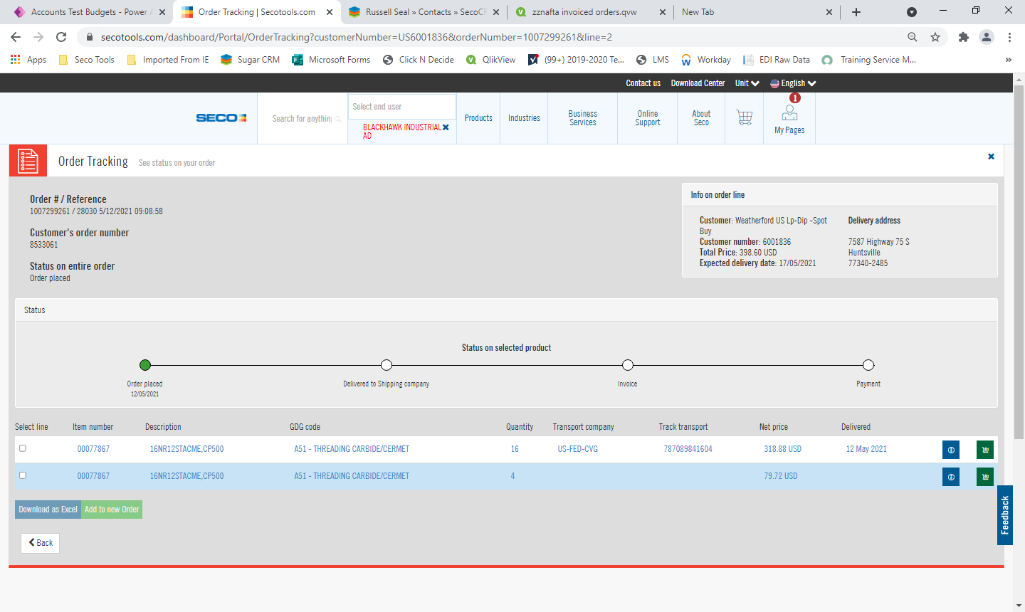
ITEM LEVEL INFORMATION – BACK ORDER
In the below example, even if the overall status of the order shows as “Order Placed”, we can see that one item already shipped out (tracking number is displayed) and one is on back order
For the item on back order, the expected shipping date is displayed on the top part of the screen

Slide 17
ITEM LEVEL INFORMATION – TRACKING NUMBER
For all items that have shipped, the tracking number will be available in the “track transport” field of the detail view as shown below
Note: the date indicated in the “delivered” field is the date the item shipped from our KY warehouse, not the date the item was delivered to you or your customer

Slide 18

5
Get support

Slide 19

SECO CUSTOMER SUPPORT
Our customer support team can answer your questions regarding our Order Tracking Portlet
You can reach our customer support team at:
  customerservice@secotools.com
  1-800-832-8326, #1

Slide 20

Thank you!

