Slide 1

NEW MY PAGES PORTLET FOR CUSTOMER RETURNS

Slide 2
YOUR SAFETY IS
OUR TOP PRIORITY
EMERGENCY EXIT
ALARM
ASSEMBLY POINT
EMERGENCY NUMBER
PROTECTIVE EQUIPMENT
PSYCHOLOGICAL SAFETY*
*Psychological Safety means to include everybody in the meeting (including yourself),
sharing knowledge, listen to other people and confirming their contribution.

Slide 3

AGENDA
Access the online return portlet
Start a new return request
Create the return lines
Finalize the return
Get support

Slide 4

1
ACCESS the portlet

Slide 5
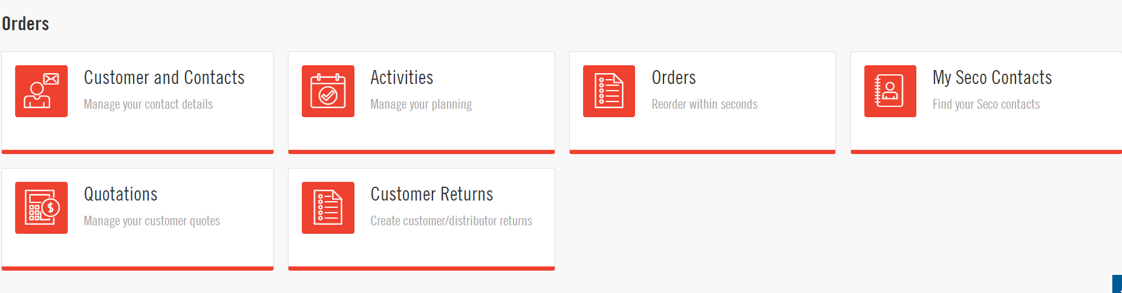
USE YOUR MY PAGES ACCOUNT
Go to secotools.com and click on My Pages
After signing into your account, you will see all the different portlets you have access to, including the new portlet “Customer Returns”

Slide 6
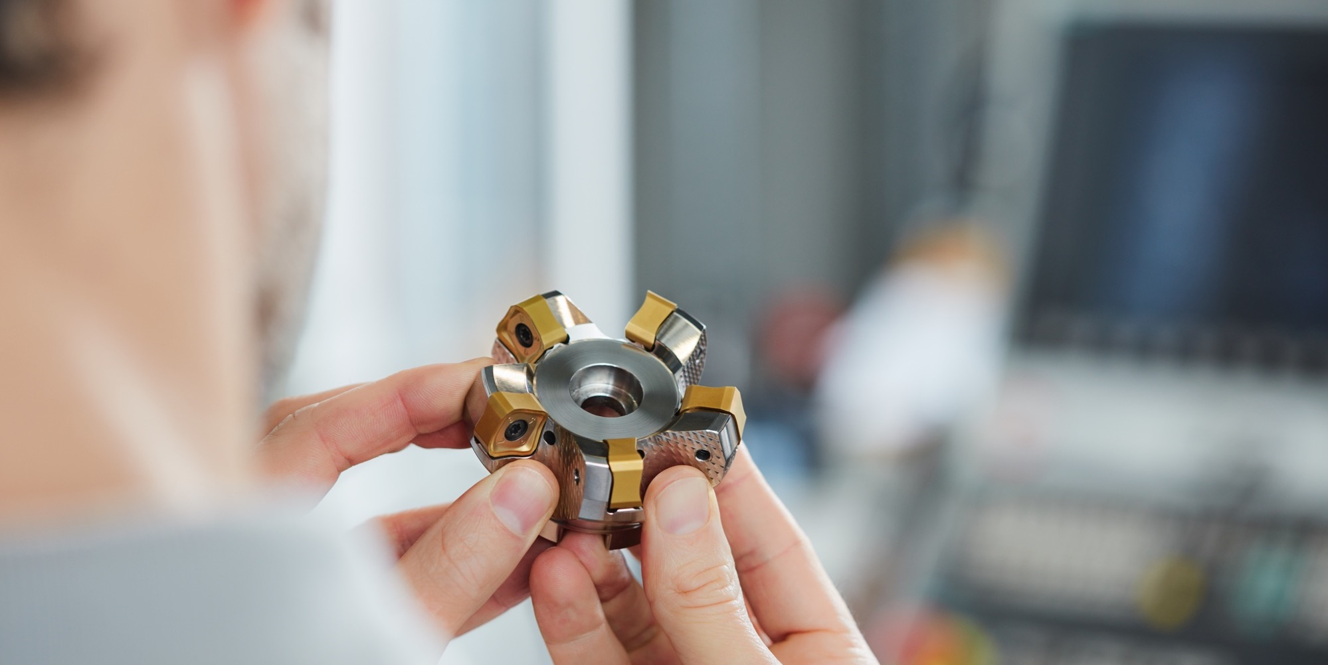
2
START A NEW RETURN REQUEST

Slide 7
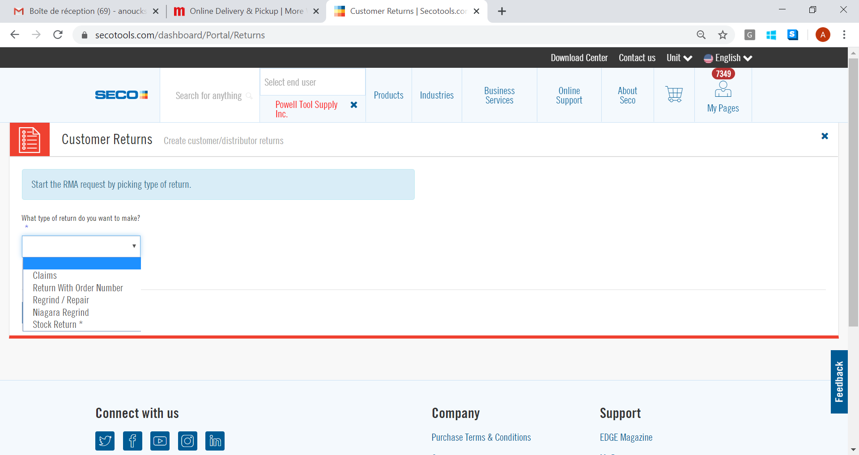
SELECT THE RETURN TYPE
All return types require an order number except for stock returns, which are standard product returns
Claims and Regrind Return Types will only be available in a future version of the Portlet

Slide 8
RETURN FOR STANDARD ITEMS
There are 2 options for returns of standard items:
  Return with Order Number: an order number is required so the credit amount can match the invoiced price
  Stock Return: when you do not have the order number available. Credit will be processed at current standard pricing
  Note: standard returns for orders placed prior to the implementation of our new ERP system (i.e prior to May 11th, 2020) must be processed as stock returns as there will be no order history in our system

Slide 9
OTHER RETURN TYPES
  Other Return Types will only be available in a future version of the Portlet
  Claims: to be used for quality issues
  Regrinds:
    Use the “Regrind/Repair” type for Seco items
    Use the “Niagara Regrind” for Niagara items

Slide 10

3
CREATE THE RETURN LINES

Slide 11
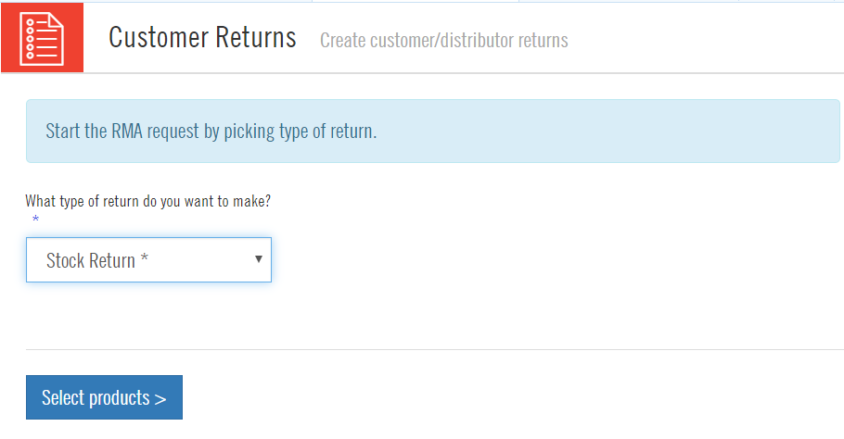
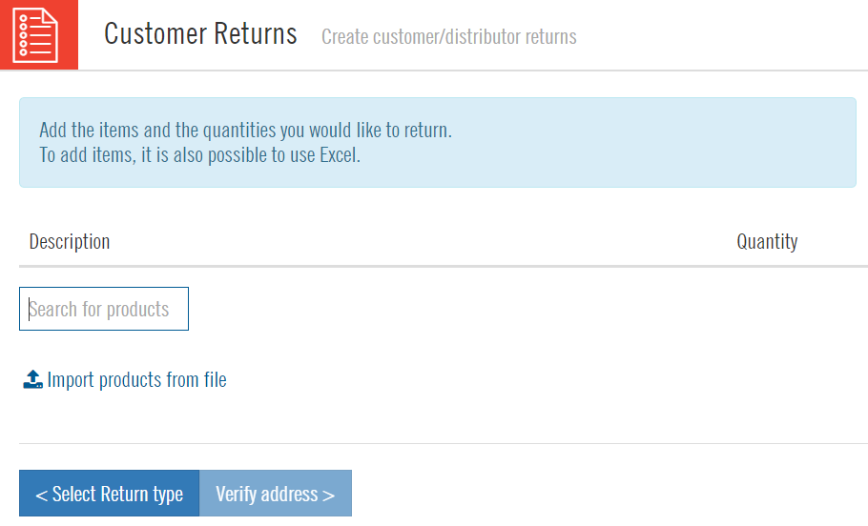
PRODUCT SELECTION – STOCK RETURN
For stock returns, you will be prompted to enter the product numbers first
1) Click on “Select Products”
2) Type in the product number in the search box

Slide 12
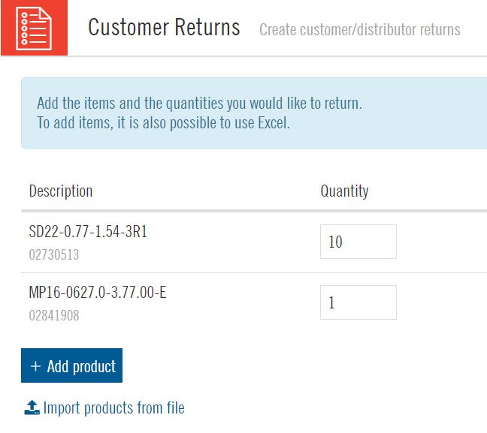
PRODUCT SELECTION – STOCK RETURN
You can update the quantity for each item
Keep adding more items by clicking on “Add Product”

Slide 13
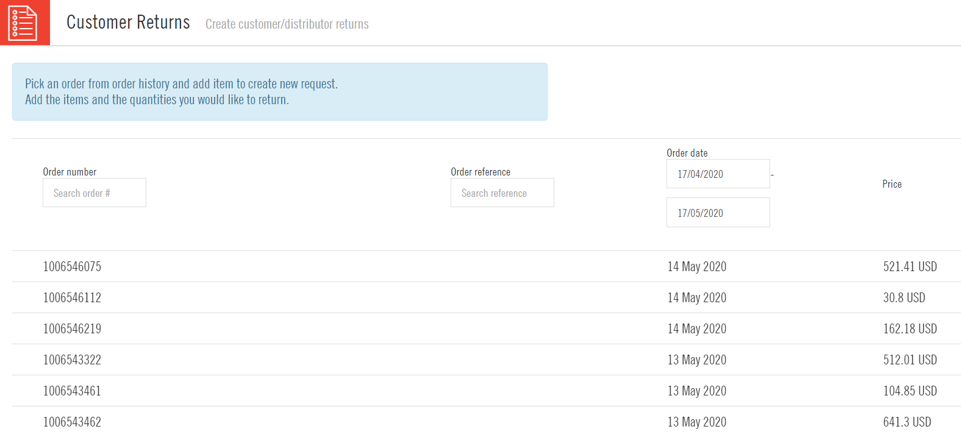
PRODUCT SELECTION - ALL OTHER RETURN TYPES
For all other return types, you will have to select the order number first. A list of your orders will be automatically populated so you can easily select the correct one.

Slide 14
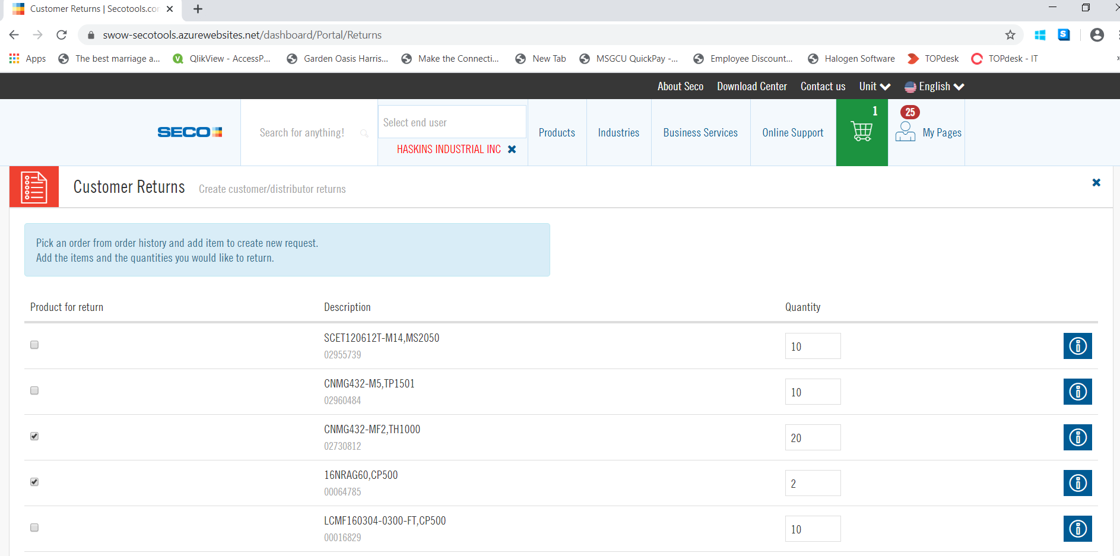
PRODUCT SELECTION - ALL OTHER RETURN TYPES
After the order number is selected, choose which items form the order you want to return by checking the box next to each one
You can also modify the quantity to return (as long as it matches our package quantity)

Slide 15

4
FINALIZE THE RETURN

Slide 16
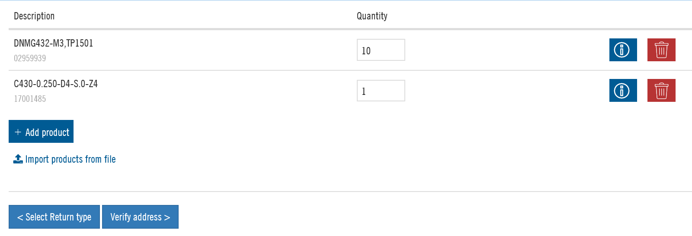
ADDRESS INFORMATION
Once all items have been selected, click on “Verify Address”

Slide 17
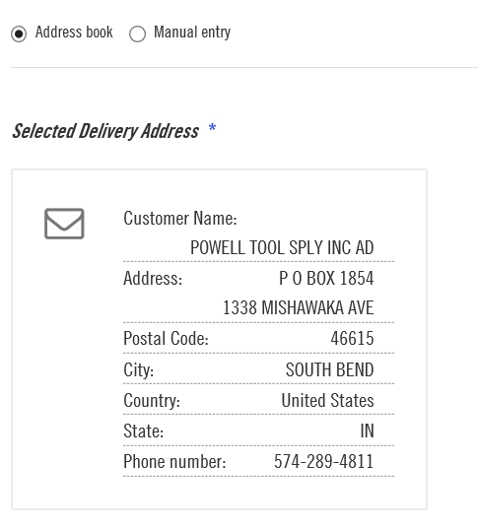
ADDRESS INFORMATION
The address book will display the main address for your company. To return the products from a different location, select “Manual Entry” and type in a different address
The selected address is the sender address that will appear on the return document

Slide 18
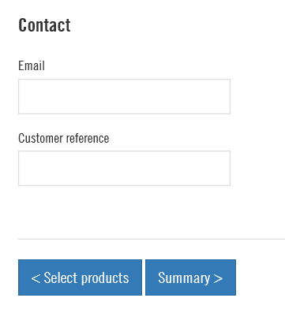
CONTACT INFORMATION
Scroll down on the previous address screen to enter additional information:
  The email address where the return document will be sent
  The reference you want to indicate for that return
Proceed to the Summary screen when done

Slide 19
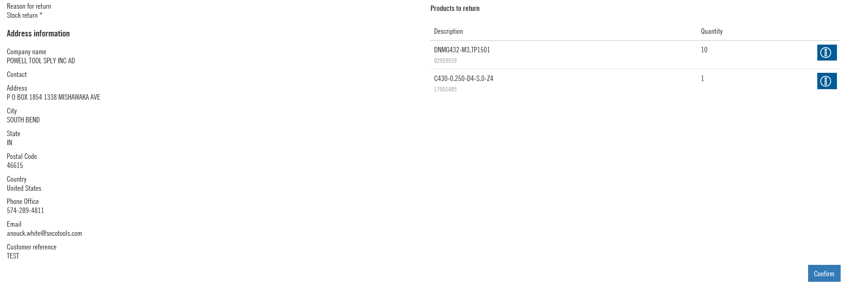
REVIEW THE RETURN SUMMARY
Make sure that all the information is accurate before submitting the return. Click on “Confirm” to complete the return.

Slide 20
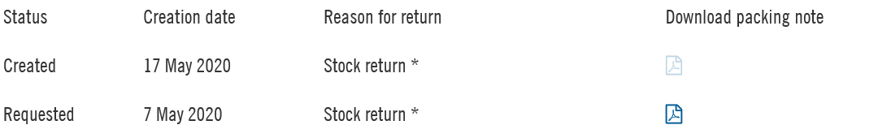
PRINT YOUR PACKING SLIP
After the return is submitted, it will appear in your list of created returns.
You will be able to download the packing slip with the shipping address to use

Slide 21

5
Get support

Slide 22

SECO CUSTOMER SUPPORT
Our customer support team can answer your questions regarding new or pending returns
You can reach our customer support team at:
  customerservice@secotools.com
  1-800-832-8326, #1

Slide 23

Thank you!

